Slide 1
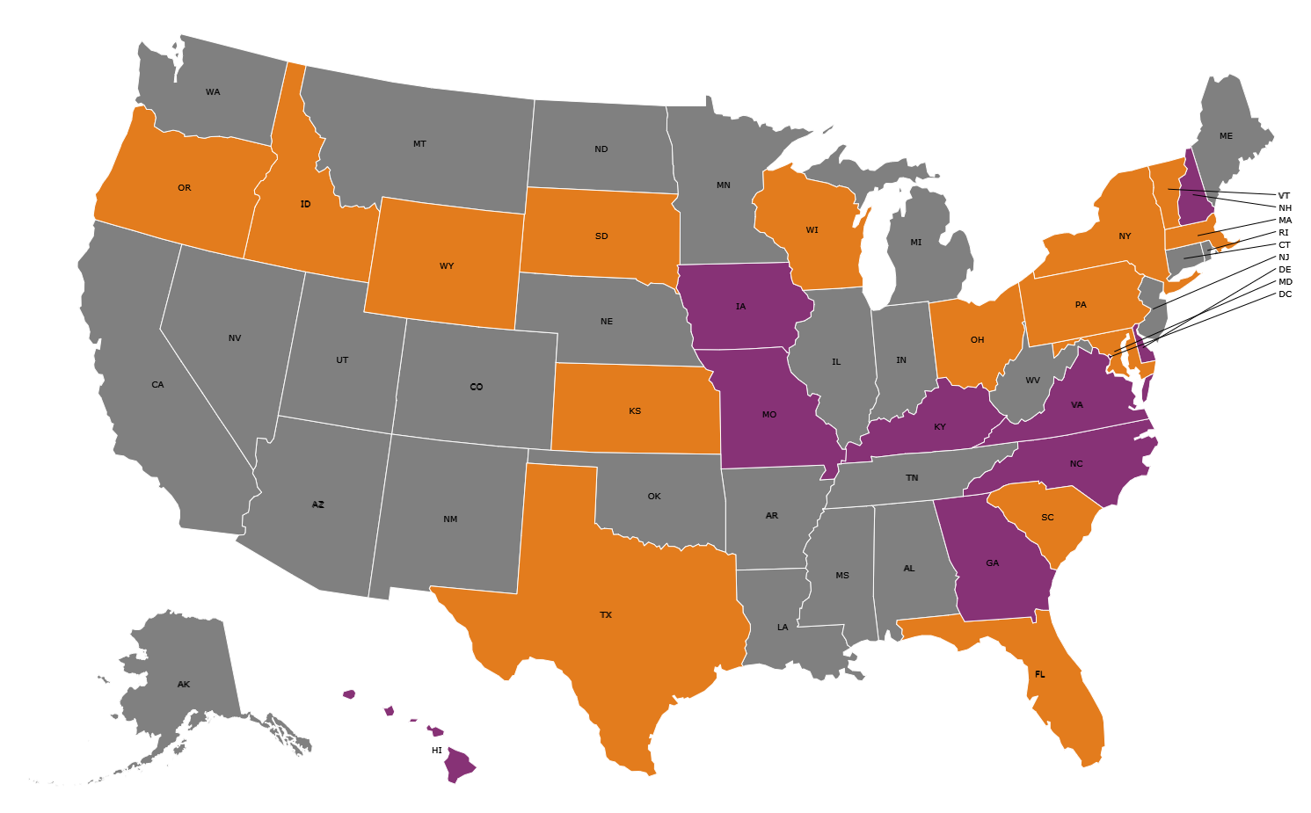


US Map showing which States Require or Recommend use of the AAP Recommended Algorithm for Critical Congenital Heart Disease Screening
= Required by law
= Recommend or Referenced
Pediatrics, Letter to Editor
https://pediatrics.aappublications.org/content/146/1/e20191650/tab-e-letters
Notes:
10 states in purple plus D.C. require AAP; an additional 16 in orange reference of recommend the AAP algorithm and the remaining 24 states don’t specify a protocol in the state law. For more specific details, can reference the letter to the editor in Pediatrics at the above website…
Pediatrics, Letter to Editor
https://pediatrics.aappublications.org/content/146/1/e20191650/tab-e-letters

