Slide 1
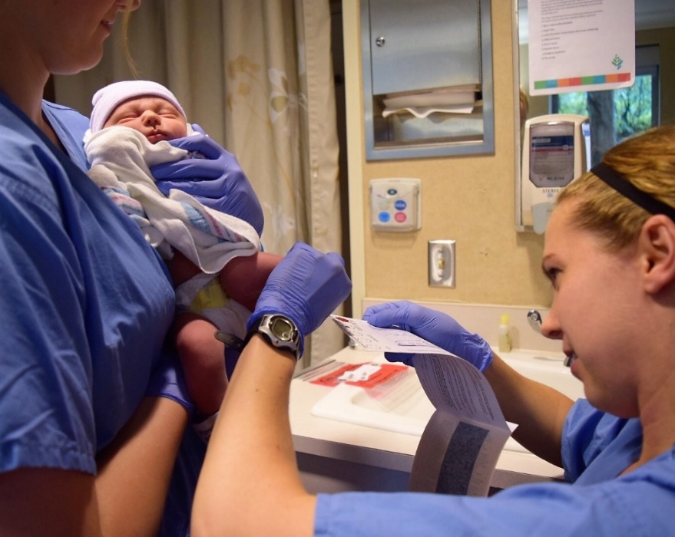



Saving lives with a simple blood spot
Interoperability for Newborn screening Programs

Slide 2
APHL Health Information Technology Webinar Interoperability
December 10, 2019
Ashleigh Ragsdale, MPH
Newborn Screening Epidemiologist
Washington State Department of Health

Slide 3
Why are we here?
What is interoperability?
Why is interoperability important for Newborn Screening?
What is the current state of interoperability?
What is the future state of interoperability for Newborn Screening?
What are the barriers to interoperability?
Notes:
Review to make sure the presentation follows this flow

Slide 4
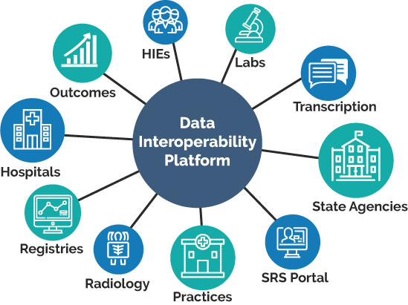
What is interoperability?
Interoperability:
The exchange of data between computer systems or software that leads to the use of the information that is exchanged

Slide 5
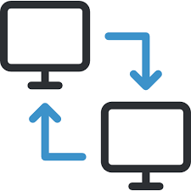
What is interfacing?
Interfacing:
the act of two or more electronic devices interacting or communicating to exchange information
When my phone sends your phone a text message our phones are interfacing
Notes:
Data integration may not be interfacing, may be manual

Slide 6

Interoperability vs Interfacing vs Integration?
Interoperability encompasses the entire exchange process, which includes interfacing, and the use of the information exchanged.
Interfacing is the act of exchanging.
Data Integration involves combining data residing in different sources and providing users with a unified view.
Notes:
The I’s of HIT. We often use these terms interchangeably

Slide 7
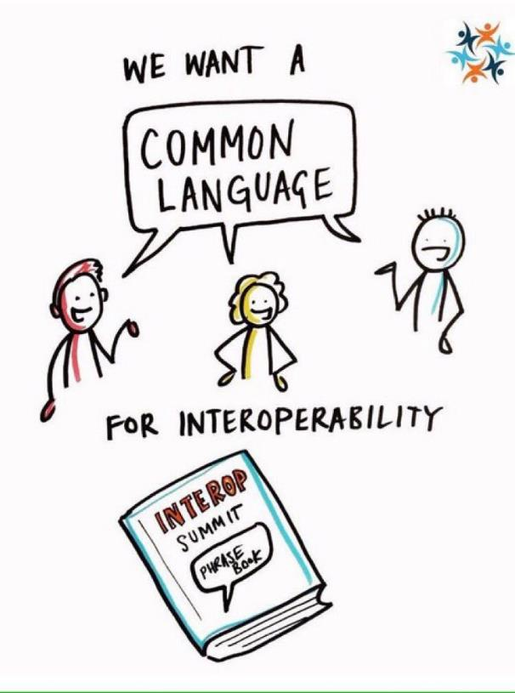

Components of Interoperability
In order for databases to be interoperable, they need a connection, a data route and a common language
Notes:
There are issues around and things to consider and discuss, vocabulary standards (LOINC) and syntactic standards (HL7, XML)

Slide 8

Interoperability Basics in Newborn Screening
Interoperability is done every day in Newborn screening when the laboratory information management system (LIMS) used in the laboratory interfaces with the case management system (CMS) used by newborn screening follow-up
But that is not where interoperability for NBS ends…..
LIMS
CMS
Data
Notes:
Show them how interoperability is currently working and part of the system already

Slide 9
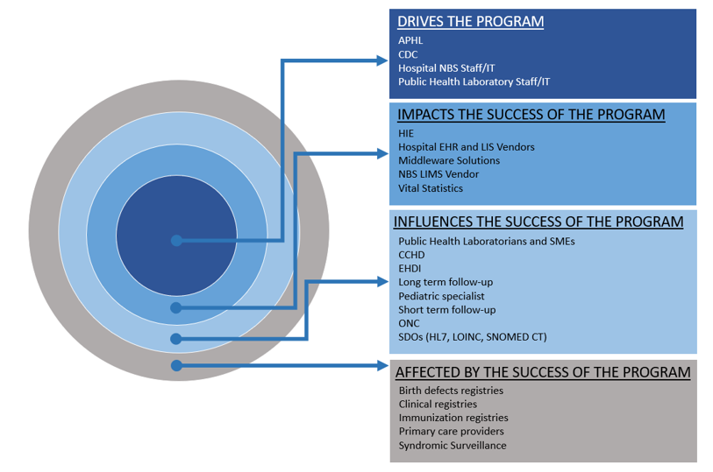

Newborn Screening Stakeholders
Notes:
Stakeholder analysis- Jmichael and CPHI
There are many stakeholders involved in NBS, bidirectional sharing of data can benefit NBS or the PH system as a whole

Slide 10
Areas of Interoperability
Specimen tracking
Electronic test ordering and reporting(ETOR)
Hearing Screening
CCHD Screening
Vital Records
Birth Defects Registry
Long-term follow-up (LTFU)
Pediatric Specialists
Data repositories
Immunization Registry
Notes:
I would say because it ensures that these entities, and the doctors and laboratorians, and nurses, and genetic counselors, researchers, and so on and so forth have the information necessary to provide desirable outcomes for infants afflicted with a NBS condition.
All of these can come together to provide info to all the appropriate parties to improve outcomes for infants

Slide 11

How many NBS programs have the following data integrated with their LIMS?
Notes:
Remember, integration is not interfacing, this could be manual

Slide 12

Data Integration with Vital Records
Linking with vital records and birth records is a critical function of NBS to ensure every baby born is screened
Identifies infants that may not have received screening
Provides a more accurate denominator for program statistics
Most states integrate with Vital Records but very few are able to fully interface
Interfacing is more reliable and accurate than exports or paper monitoring
Minnesota has an interfaced data system with vital records, allowing for automated flow of information into the newborn screening database.
Notes:
Explain why link with vital records, how it is done, benefits and how most states aren’t interfacing due to privacy concerns etc.

Slide 13



Point of Care Screening Interoperability
EMR
Demographics and contact information sent via HL7
NBS LIMS
Newborn screening staff can view data in their case management system
NBS CMS
Hearing and CCHD screening results sent directly from the testing equipment
Notes:
Example of POC interoperability, this is not how everyone is doing it, this is the ideal state for these programs, reduces errors and improves reporting factors

Slide 14
How are NBS Programs integrating CCHD data?

Slide 15
How are NBS Programs integrating EHDI data?

Slide 16

Data integration with Birth Defects Registry
Identify CCHD cases missed by pulse ox screening
  False negative feedback loop
  Targeted education
  Better understanding of CCHD in population
Quicker outcome collection after failed pulse ox screen
NBS reporting to Birth Defects will help them identify unreported CCHD cases
Notes:
Could use some work…
From MN: • Collaboration and Data Sharing with the Birth Defects program would… Allow for quicker outcome collection after a failed pulse ox screen Allow for greater understanding of CCHDs missed by pulse ox screening

Slide 17
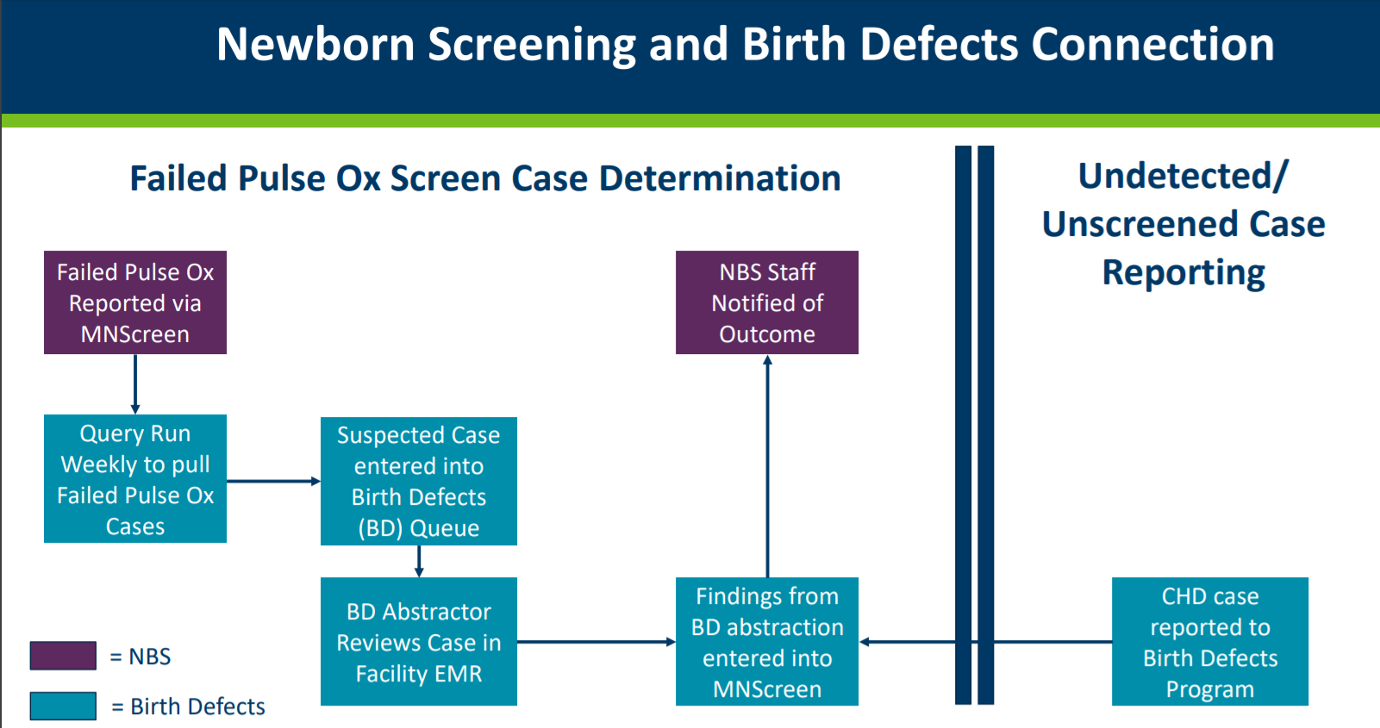

Slide 18
Electronic Test Ordering and Reporting (ETOR)
Slide courtesy of Brendan Reilly
Texas State Health Services NBS
Notes:
Go through the process of ETOR explain the basics
Use case, CF mutation in their HMS but the specimen was actually normal

Slide 19
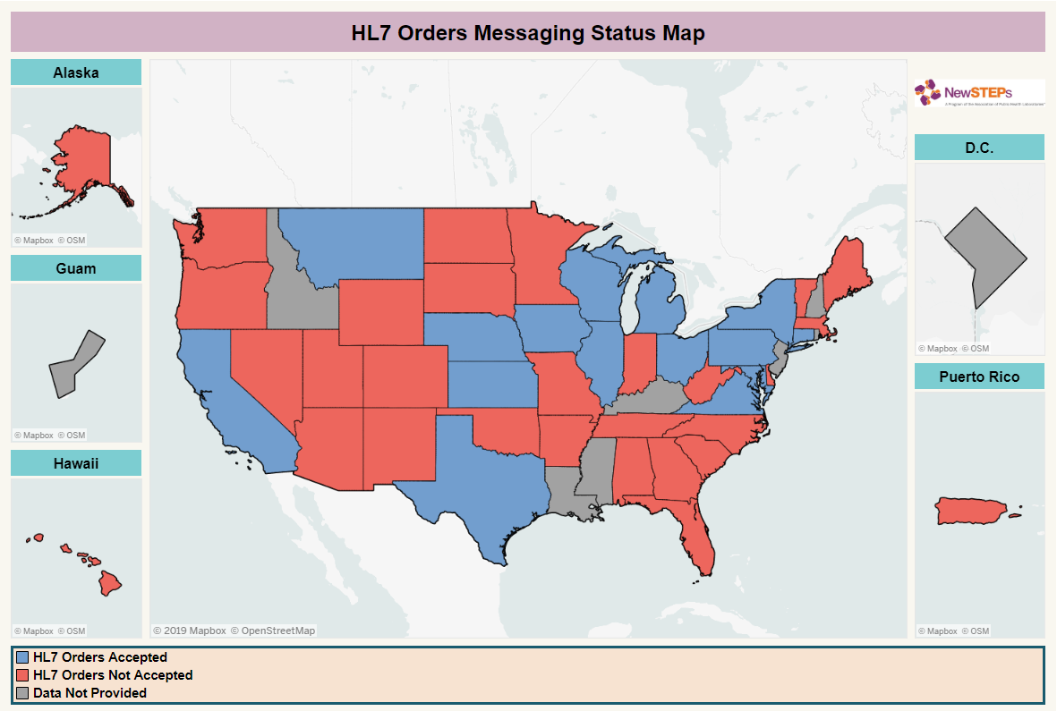
Notes:
Current state of ETOR

Slide 20
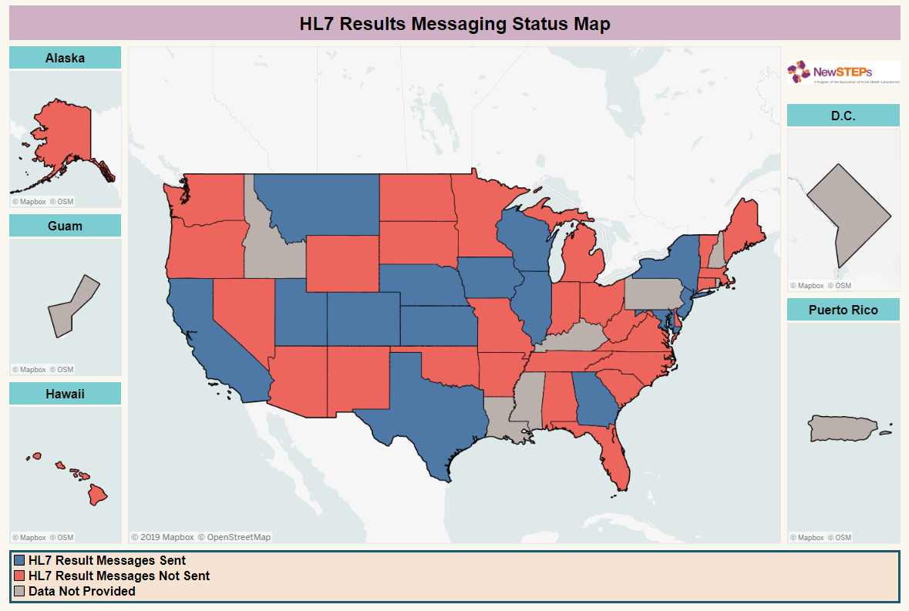
Notes:
Current state of ETOR

Slide 21
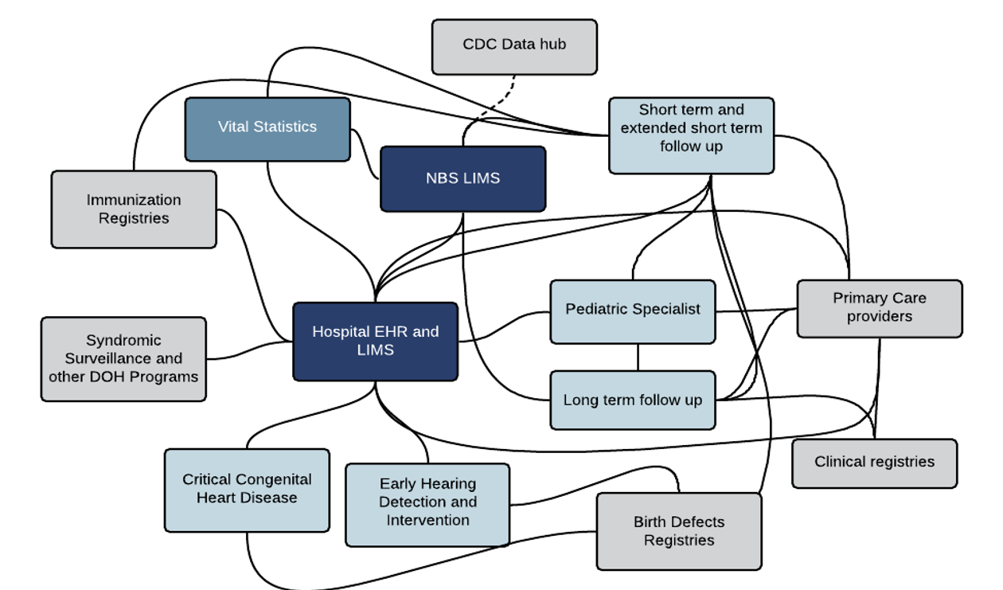
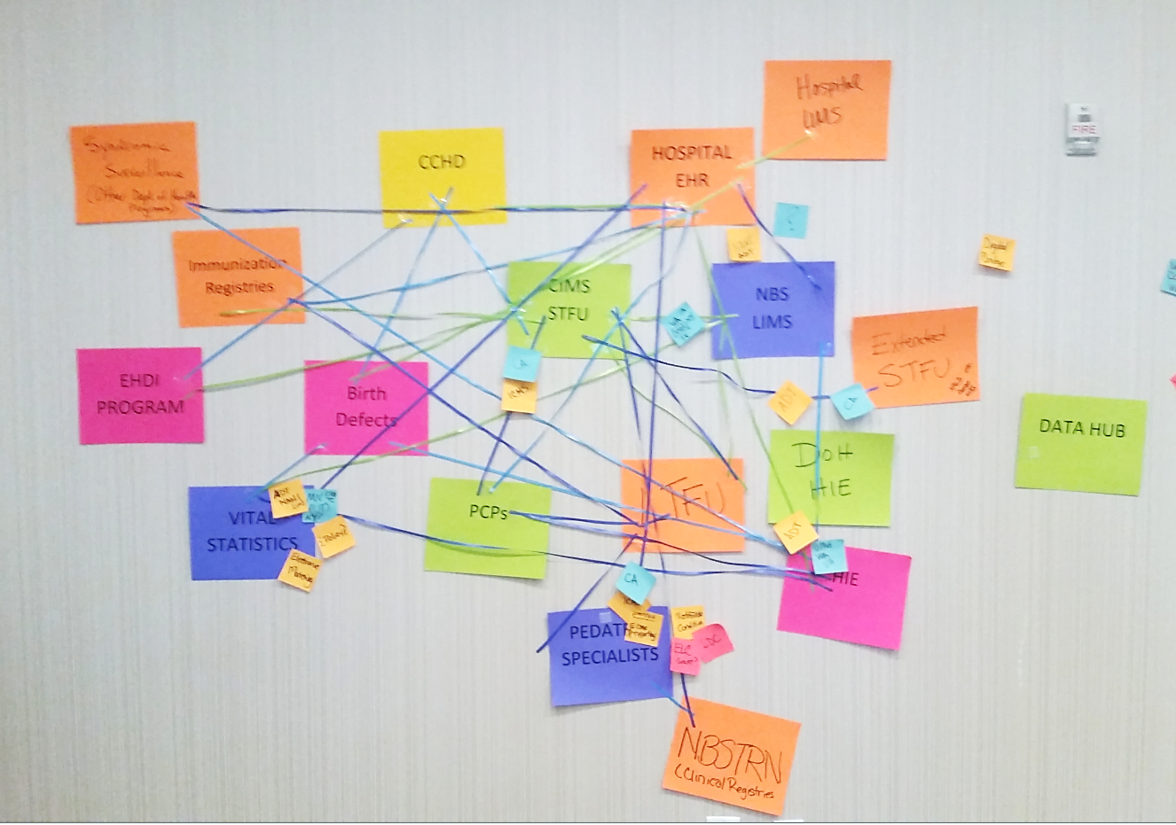
The NBS Spider Web
Notes:
Now we have examined some of the individual connections, as you build connections you begin to develop a web of connections –need to reference JMicheal

Slide 22
Newborn Screening Lab Xanadu
Slide courtesy of Brendan Reilly
Texas State Health Services NBS
Notes:
Lab inventory- receive kits into an inventory module which interfaces with LIMS, scan the form and it could import expiration dates, submitter etc
What is and ADT?
ADT- end value of all births, notification of specimen collected
Tracking specimens, cant fully do it without knowing a baby was born
Use the ADT for initiation of FU, hospital discharge data (who is the PCP) rolling feed with most recent up to date info on who is caring for the child. Discharged to the care of someone
Clinical Dx- Dx info through a rolling ADT, what testing has been completed, is there a diagnosis, missed cases (lab feedback loop). Eliminates the manual processes for Providers to send data back to the DOH- improve algorithms and reduce false negatives.
Variant analysis- Bioinformatics pipeline, using FHIR to share raw data files with a centralized bioinformatics pipeline. Could be sent off and have analysis completed for you or in conjunction, update variant databases- receive notification on specimens where the variants have been identified if they are updated.
Biochemical Risk Analysis-interfacing with CLIR or CDC to send to a repository for external feedback
**Provides an audit of the NBS system assessing whether NBS is doing what it is supposed to do, particularly for late onset disorders

Slide 23
What’s in Xanadu?
Birth notifications
Specimen tracking
Real-time quality monitoring
Real-time patient follow up info
  Current provider
  Diagnosis
  Treatments
  Diagnostic testing status / results
  Long-term follow-up measures
Reduced data entry
Simplified order messaging

Slide 24

Hospital
Perspective
Notifiable Conditions
Syndromic Surveillance
Hospital Acquired Infection
Lab Results
Births, Deaths, Fetal Deaths
Hospitalizations
Immunizations Surveillance System
Cancer Registry
Newborn Screening
Child Health Form
Trauma & Emergency Services
Prescription Drug Monitor
Death with Dignity Data
Incident and adverse events report
Birth Defects Surveillance System
Integrated Licensing and Regulatory System
NBS Point of Care (Hearing, CCHD)
HTTPS (preferred), HIE (Development)
Mail
Mail/fax
Notes:
In the long term, what is the most efficient way for data to come into the agency?
Can all data enter the agency through a few mechanisms?
How many different tools are needed to process data?
If this is not what we want…what do we need to

Slide 25





Agency Xanadu
Public Health Laboratory
EHDI
CCHD
Immunizations
Vital Records
NBS
Cancer Registry
Agency Data Hub
Birth Defects
Healthcare Providers
Slide courtesy of Brendan Reilly
Texas State Health Services NBS
Notes:
Centralized processing of data, so hospitals are connecting and sending the same information only once

Slide 26
Public Health Xanadu
Notes:
Using the same pipelines

Slide 27
Recap of Interoperability Benefits
Identification of False Negatives
Identify babies that may have missed screening
Improved data quality
  Timeliness
  Completeness and accuracy
  Integrity of the data
Improved data security by reducing faxing/emailing/mailing of PHI
Defined case definitions, updating disease status or change in diagnosis
Increased efficiency for NBS staff, hospital/submitter staff and other public health staff

Slide 28
Barriers to Interoperability
Agency policy
Agency-wide informatics infrastructure
Program prioritization (opportunity cost)
Having the right partners at the table
Privacy issues
Funding sources
Lack of trained professionals in Public Health Informatics
Data standards are like toothbrushes. Everyone agrees they are a good thing but everyone wants to use their own
Notes:
New disorders being added frequently
Partners: Functioning in silos, partners are not on the same page as much as we hoped they would be (readiness) NBS is just a piece of what they are working with, prioritization issues at the partner level
IT security Issues and perceived privacy issues (public sentiment)
Funding: IAPD is sun setting, ETOR in ELC, programs don’t know how to tap into it, agencies cant capitalize on it. Funding on the hospital side to do the interface (for example, we heard a quote of 20K just to purchase the interface)

Slide 29
Why are we telling you this?
Expanded interoperability allows NBS to:
  Gain efficiency
  Redirect FTEs
  Increase testing accuracy
  Improve patient outcomes
How can we advance these efforts:
  Encouraging agencies to develop interoperability priorities
  Developing a lab level interoperability plan
  Pursuing interoperability funding opportunities
  Expanding informatics workforce/training programs
Notes:
At minimum make sure the agency is developing a vision for shared informatics/plan
We really want you to tell us how you can help?

Slide 30
Thank You!!
Brendan Reilly – TX NBS
Joshua Miller - CPHI
Dave Jones – UT NBS
Tony Steyermark – MDH
Amy Gaviglio – MN NBS
NBS HIT Workgroup
APHL & NewSTEPs
JMichael Consulting
Ashleigh Ragsdale, MPH
Epidemiologist, Newborn Screening Program
Washington State Department of Health
Ashleigh.Ragsdale@doh.wa.gov

Slide 31
Questions?

Slide 32



Thank You
Amy Gaviglio MS LCGC
David Jones PhD, Ashleigh Ragsdale MPH, Anthony Steyermark PhD, Dari Shirazi, Emily Hopkins MPH, Marci Sontag PhD, Careema Yusuf MPH, Guisou Zarbalian MPH, Carla Cuthbert PhD, Audra Van Horn, Rachel Shepherd, Vanessa Holley, Crystal Fitzhugh, Evila Atkinson

Slide 33
Agency Interoperability
Public Health Providers
Public Health Surveillance Systems
Hospitals
1. Electronic Lab Reporting
Professionals
2. Cancer Registry
Critical Access Hospitals
3. Immunization
Substance Abuse
OneHealthPort
Interoperability
Engine
(Rhapsody)
4. Prescription Review (PMP)
Long Term Care
5. Syndromic Surveillance
Behavioral and Mental Health
APHL
(AIMS Hub)
eHealth
Exchange
6. Electronic Case Reporting
Pharmacies
Laboratories
7. Newborn Screening
Correction Health Providers
8. Emergency Medical
EMS
9. Child Health
Local Public Health Providers
10. Life Events (Birth/Death)
11. Lab Information
Notes:
To be successful in the future, public health agencies must advance our surveillance systems so that timely, complete, accurate and granular data are available for public health decision-making. The Washington State Department of Health (DOH) is working to collect surveillance data in an automated, electronic way to ensure data transmitted to public health are timely and complete

Slide 34
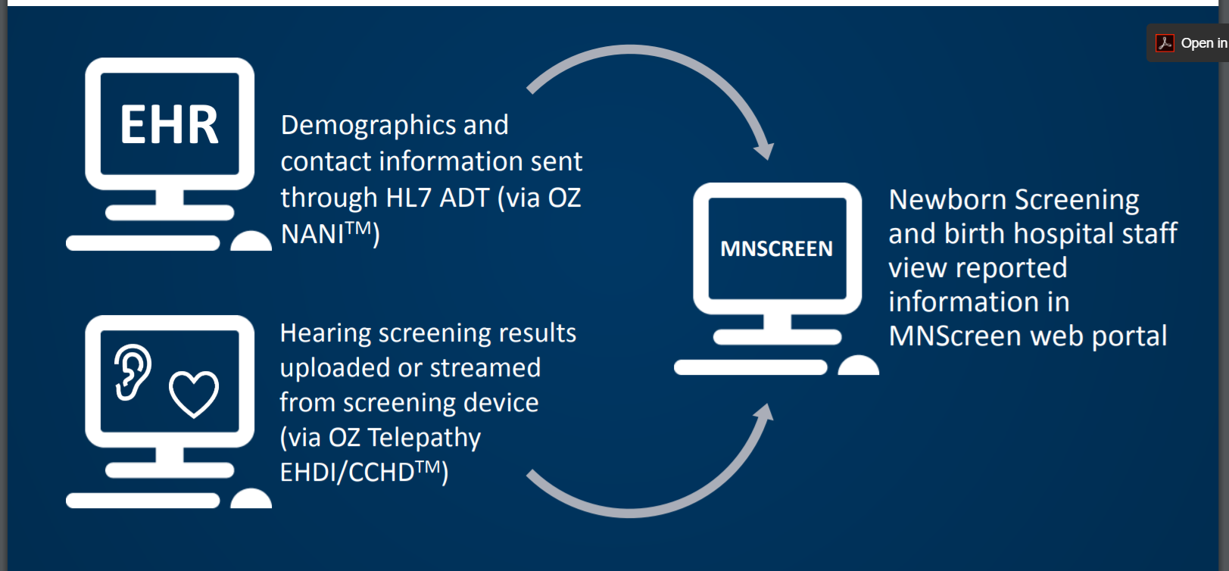

Slide 35
The Lab Spider Web
NBS
Clinical Chemistry
Microbiology / Emergency Prep
Environmental
DSHS Childhood Lead Poisoning Prevention
Healthcare Providers
Notes:
Do we need this one?

Slide 36
Hospital Spider Web
Laboratory
EHDI
CCHD
Immunizations
Vital Statistics
NBS
Clinical
Micro
Env.
Lead Poisoning Prevention
Cancer Registry
Birth Defects

Slide 37

Collect
Parse
Data routing
Data load
Secure data exchange
Link
De-Dup
Vocab
Healthcare
Labs
Tribes
Local Health Departments
Public
Visualize/ Share
Core Services
Prepare
Processed
Data Extract
Open Data
Data extract to meet analysis or sharing need
Routine or question driven data analysis
Analyze
Provision
Notes:
Description of each core function
Description of each function
Collect
Parse—like data entry
Prepare—linking, de duplicating
Provision—extract from something
Analyze—
Visualize/Share
How many systems do we need to do each of these things?
(Look at hospital perspective slide and come back)
Modular—
All our systems do more than this
if agency buys something that does these—what is left
Sell vaccine. Well, what else do we sell.
Programs have unique needs. We do not have the resources to continue to build and maintain unique IT systems to meet these needs.

Slide 38





Informatics-Savvy Health Department
Data and information management at DOH
Data into Information
Managing and improving information governance
Sharing/Exchanging Data
Developing informatics workforce
Notes:
Slide purpose: Introduce the focus areas of the WA informatics roadmap
Addl’ talking points: Consider highlight/mention that you broke the original 3 groups into 5 goals to be able to more easily identify objectives and actions.
Addl’ direction: N/A
WA Speaking Notes:
1. Enable and support the development of well-designed, maintained and effectively used information systems
2. Improve efficiency of intra-/inter-partner data exchange and effective use of data
3. Analyze and disseminate data and information in a timely, ethical, open and transparent way
4. Create an Information Governance framework that addresses multi-disciplinary information management
5. Develop informatics trained and/or experienced leadership and work force

Slide 39
From ----- To

Slide 40
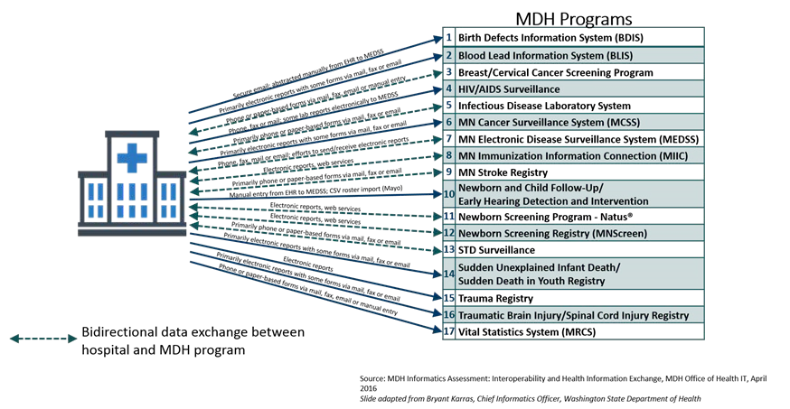

Slide 41
10 YEAR
National networks

Slide 42
3 YEAR
Identify challenges and opportunities for each line
12
Specific use cases
National networks

Slide 43
Project/ideas | Challenges | Opportunity
Improve LPH exchange with MDH (using HIO) | Not EHR Funding Resource challenges | Tie to improved public health in MN
Coordinate onboarding with MDH |  | Internal MDH process change
Data synchronization, focus on feeds. Find a set we can agree on
Focus on getting data to groups that doesn’t have any
All existing feeds should be going through the exchange hub |  | MIIC
Define process for how to connect with other states. Start with WI, IOWA, SD, ND
Define process for how we should receive lab information (including reference labs)

Slide 44
Details | Challenges | Opportunity | Goal
Non EPIC providers | Is MDH ready? Funding constraints | Find a program/use case for a dataset the programs want (MIIC?, MNTrauma?)
EPIC Providers (12) | Existing connections in place Uncoordinated requests from MDH | Move connections over to use HIO for new use cases/feeds Opportunity to make changes when other things change. If we can be coordinated we’ll solve many issues at once | Find specific use cases to use HIO. Coordinated approach for our requests.
Local public health
Tribal health |  |  | Create a plan for how to do exchanges
Reference labs | Quality of data Unwilling to make changes unless all states are doing them We have very little control | HIO can possibly help with data quality issues | Create a plan for how to do exchanges for labs overall
Out of state public health
CDC
DHS
HIE (other states HIE) |  |  | Not have any direct connections between MDH and other states HIE. (Is this realistic?)
Out of state providers |  |  | Not to have any direct connections between MDH and out of state providers

Slide 45
Health Information Technology (HIT) in Newborn Screening
Newborn screening serves as an example of how informatics can be applied in a public health setting.
Some information may be specific to newborn screening.
Other information can be generalized to public health as a whole.
Notes:
Hmm integrate this somewhere?

