Slide 1


Screening newborn babies for CCHD using pulse oximetry:
which algorithm is best?
Andrew Ewer
Professor of Neonatal Medicine, University of Birmingham UK
Neonatologist, Birmingham Women’s Hospital
Notes:
1

Slide 2
Disclosure
Received travel and accommodation expenses
from oximeter manufacturers to present at
scientific meetings only
No payments or honoraria
from any oximeter manufacturers
No financial interests in any oximeter
manufacturers

Slide 3

Further disclosure
PulseOx Nerd

Slide 4
Overview
Decision making process for USA PO screening
Current practices – algorithm variations
Future work

Slide 5
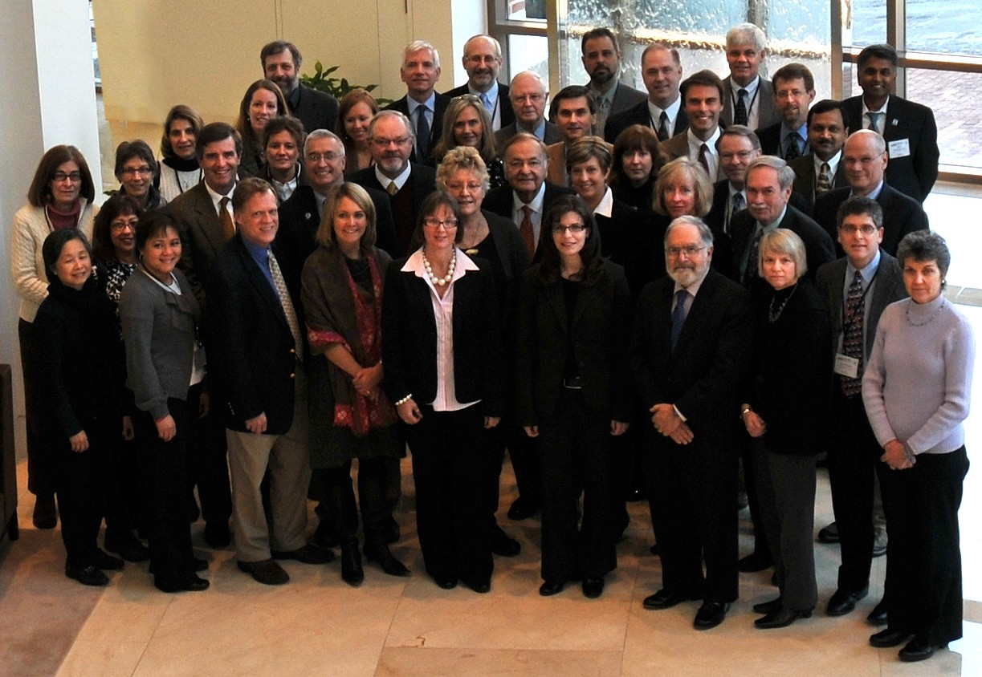
Heart House Jan 2011

Slide 6
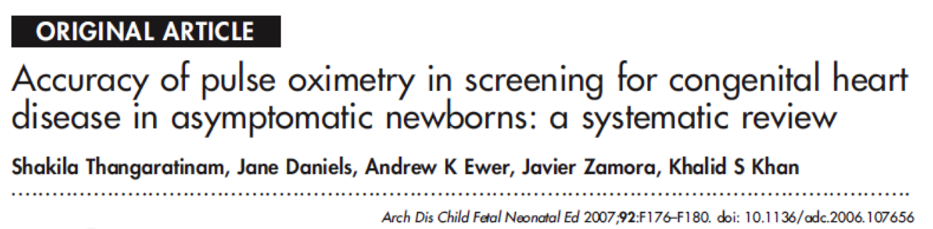
8 studies involving 36 000 babies

Slide 7
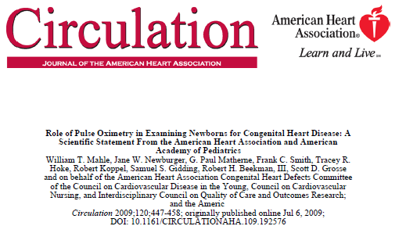

Slide 8
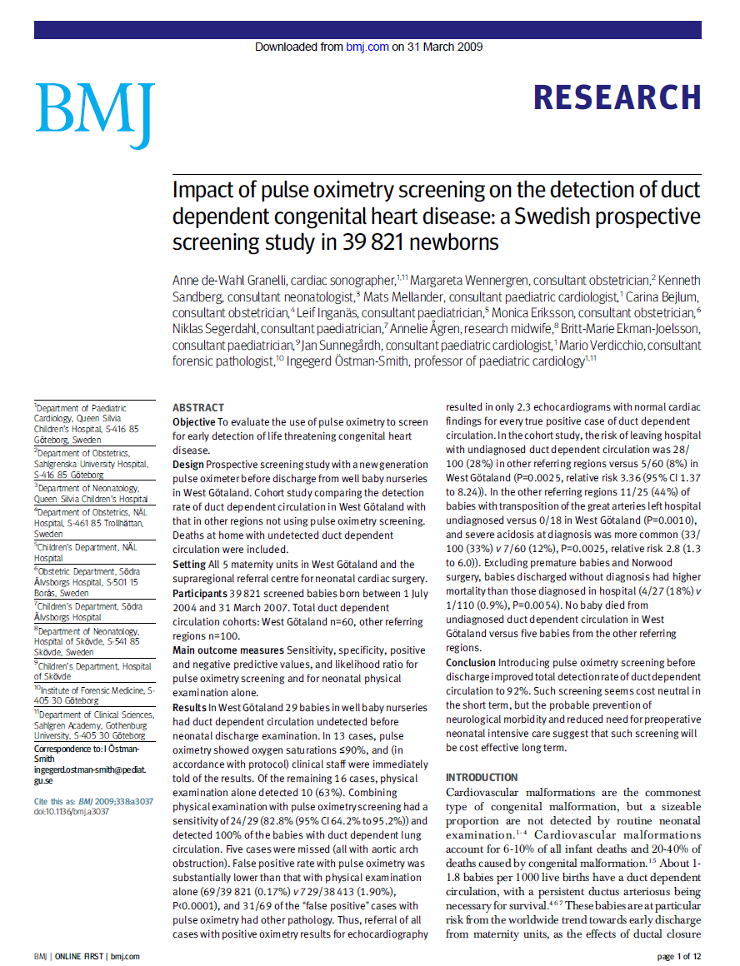
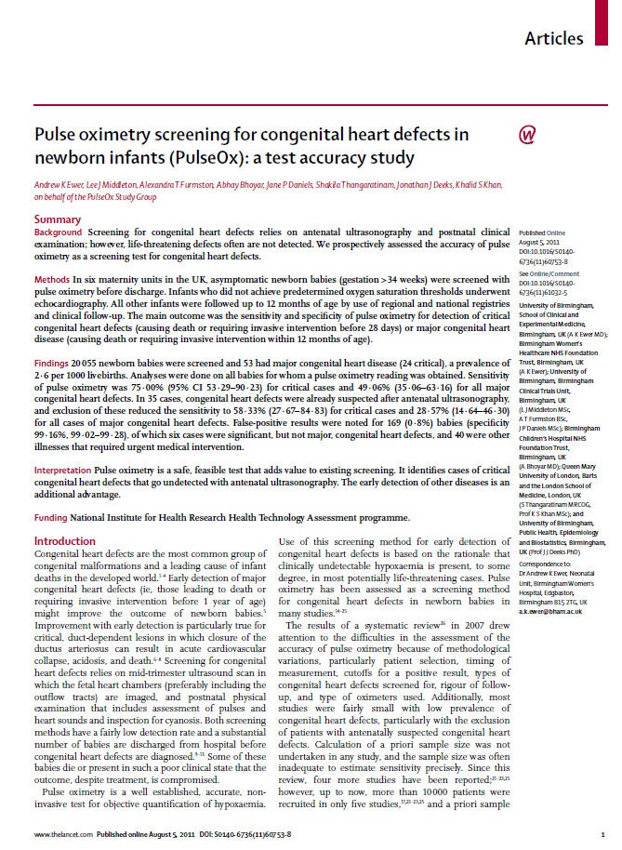


Slide 10
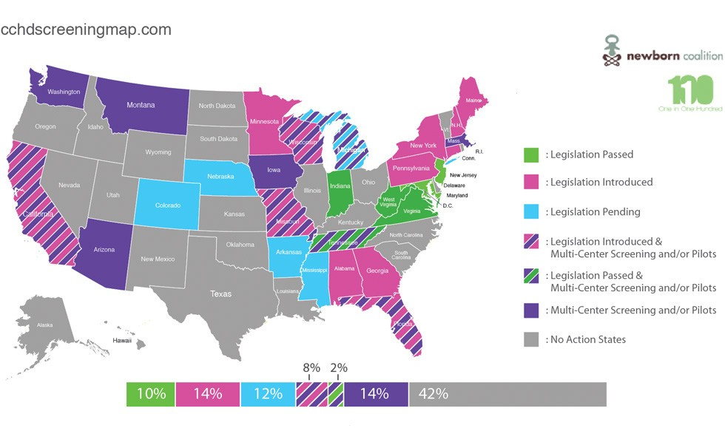
2012
From pulseoxadvocacy.com

Slide 11
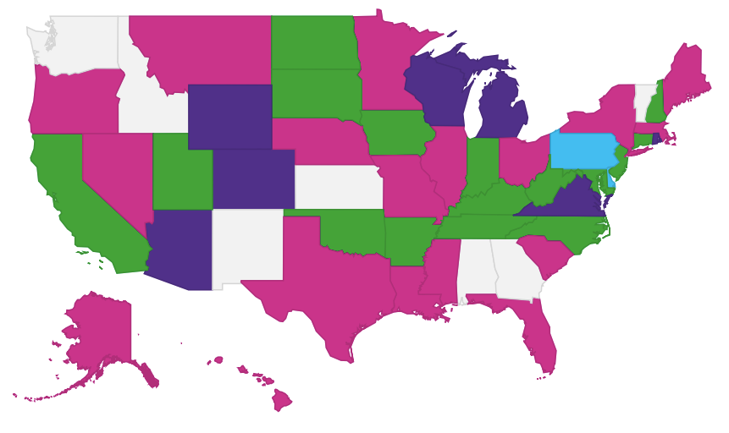
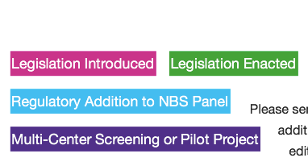
2013
From pulseoxadvocacy.com

Slide 12
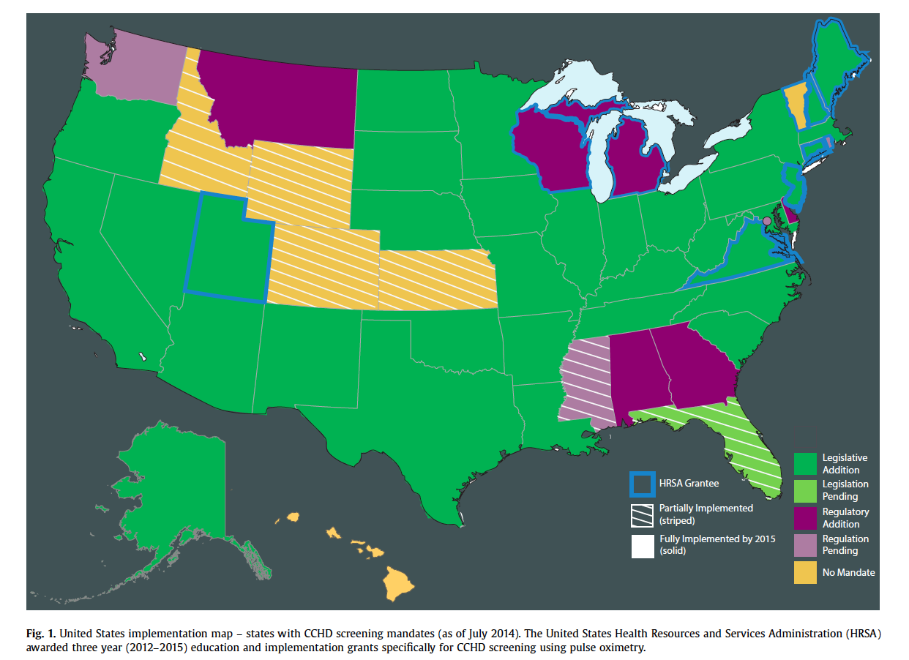
2014

Slide 13
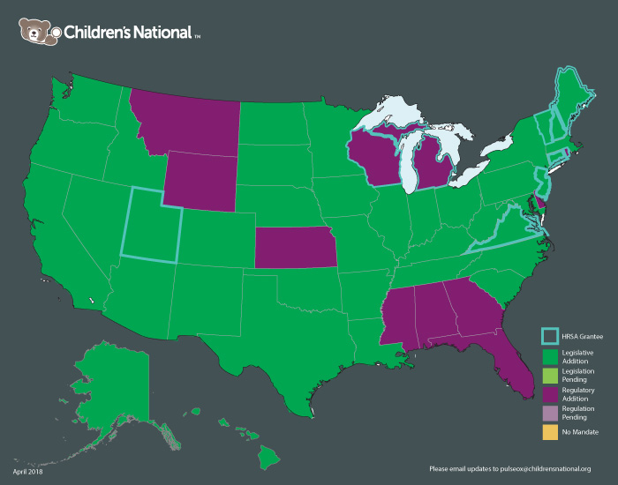
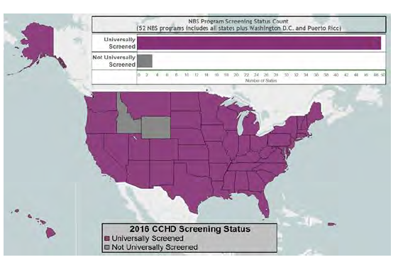
2018

Slide 14
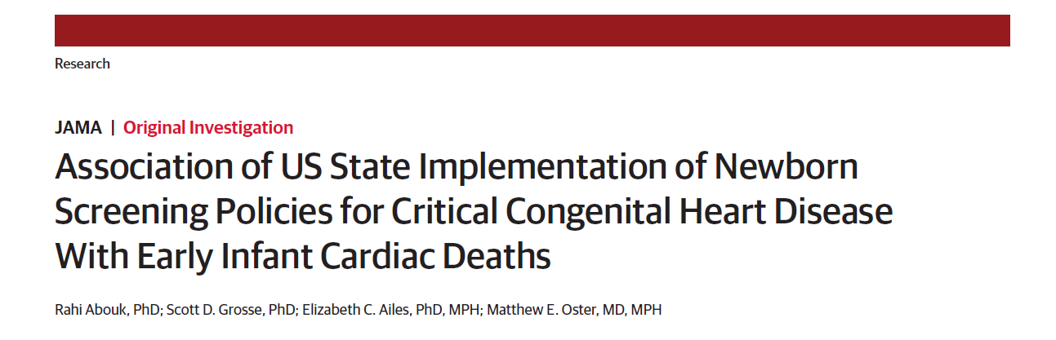

33% reduction in mortality from early deaths due to CCHD
21% reduction in mortality from early deaths
other/non specified cardiac causes

Slide 15
UK National Screening Committee
have had same data for a longer
time… and are yet to make a decision

Slide 16
Pulse oximetry screening for CCHD
Back to basics
What does a pulse oximeter measure and what is the best way to use this information to identify babies at risk?

Slide 17
Oxygen transport
Blood contains red cells
Haemoglobin (Hb) in red cells binds oxygen
Oxygen bound to Hb - OxyHb
No oxygen bound to Hb – DeOxyHb
Proportion of Hb which is OxyHb called oxygen saturations – should be 95-100%

Slide 18
Pulse oximetry
OxyHb and DeOxyHb absorb different
light spectra in different ways

Slide 19
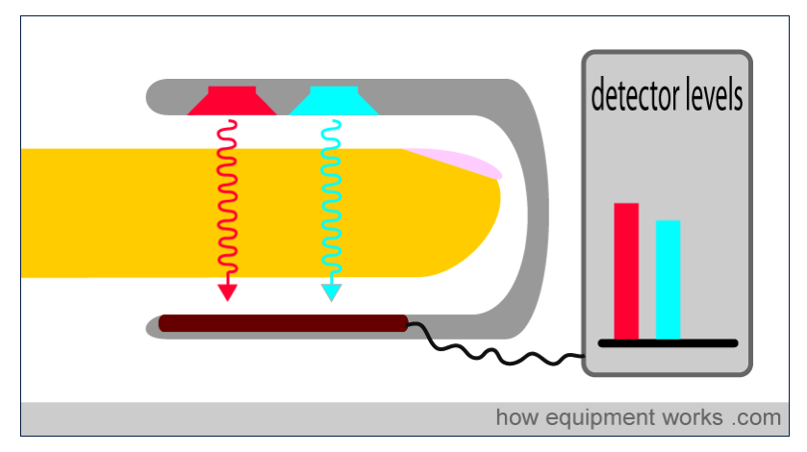

Slide 20
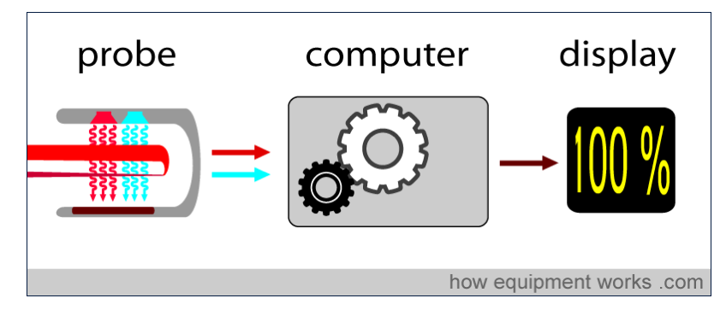

Slide 21
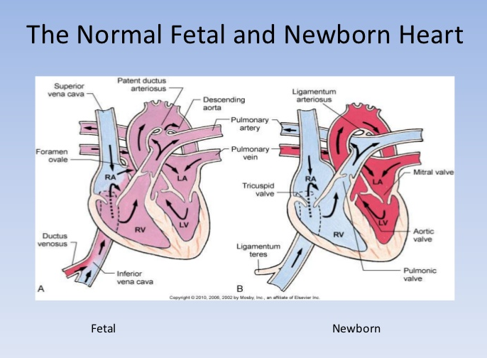

Slide 22
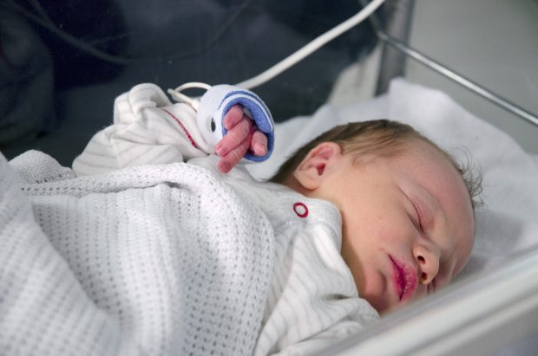
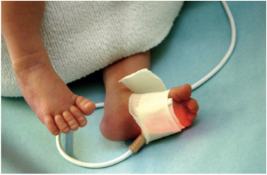
Pre-ductal
Post-ductal

Slide 23
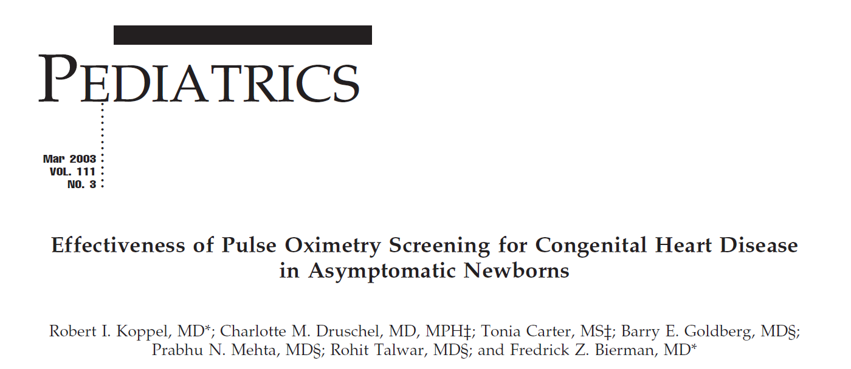
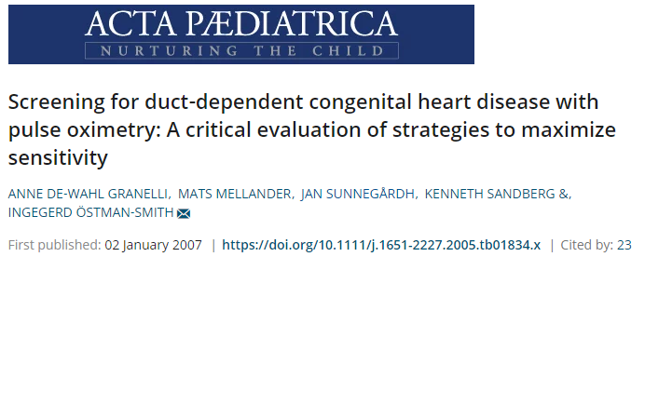
Used post-ductal saturations only
1 measurement <96%. After 24 hours of age
Used both pre and post-ductal saturations
66 cases of CCHD @ 3 days.
Most sensitive if both <95% or pre/post diff >3%

Slide 24
‘The highest sensitivity … was obtained using threshold levels of … saturation < 95% in both limbs or at least 3% difference … between foot and right hand.’
‘This is a promising technique that needs large, well-conducted studies to assess the accuracy, effectiveness and feasibility of its use for mass screening of congenital heart disease in newborns.’

Slide 25
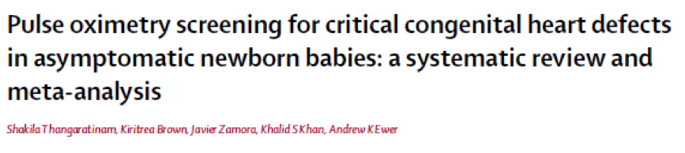
2nd May 2012
13 studies 229 421 patients (c.f. 8 studies, 36 000 pts)
Overall specificity 99.9% (99.7% -99.9%)
False positive rate 0.14% (0.06 - 0.33)
(FPR <24 hrs 0.5%. FPR >24 hrs 0.05%) 10 fold difference
Overall sensitivity 76.5% (95% CI 67.7% - 83.5%)
no difference between pre/post and post ductal testing

Slide 26
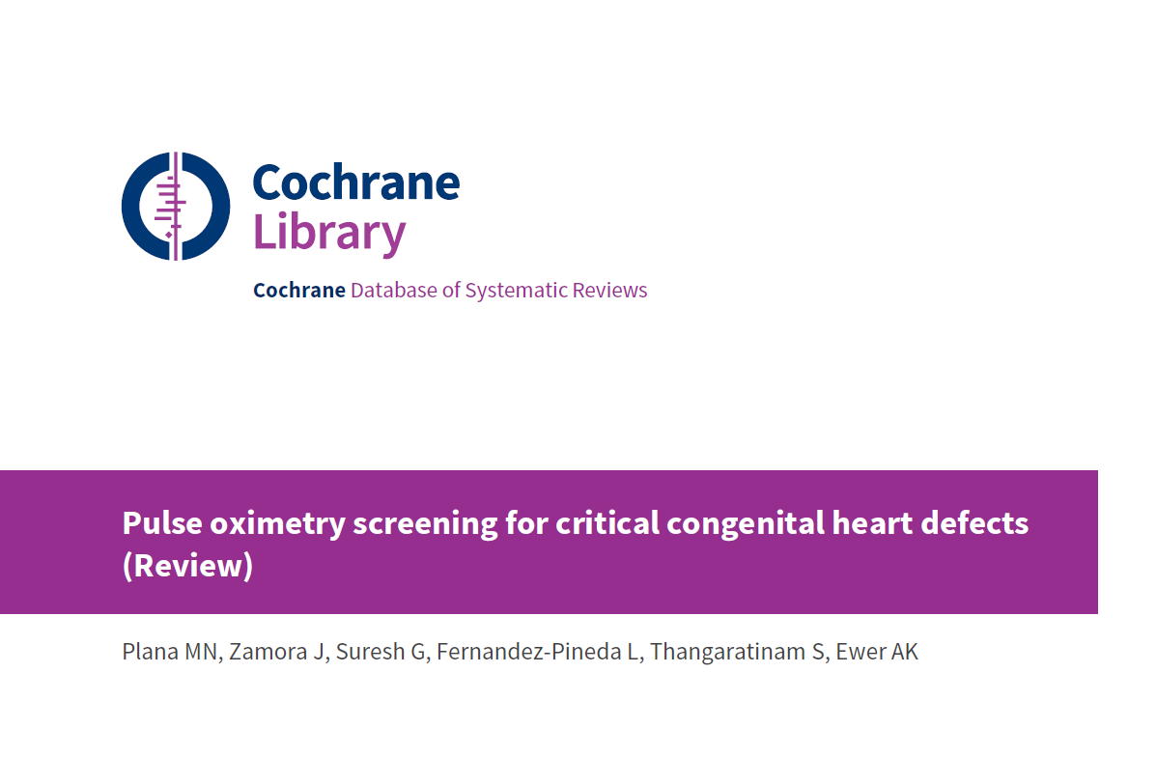
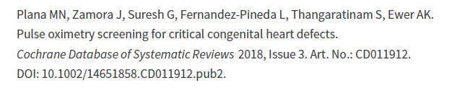
Jan 2018
21 studies; 457 202 patients studied

Slide 27
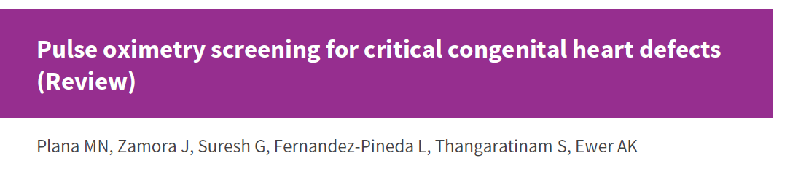
Overall specificity 99.8% (99.6% -99.9%)
False positive rate 0.23% (0.12 – 0.44)
(FPR <24 hrs 0.47%. FPR >24 hrs 0.11%)
Overall sensitivity 78.5% (95% CI 71.2 - 83.7)
No difference in sensitivity between post ductal
only and pre/post ductal testing

Slide 28
So…
Surely it’s better to screen using
post-ductal saturations only (quicker
and easier) … and after 24 hours
(much lower false positive rate) ??

Slide 29
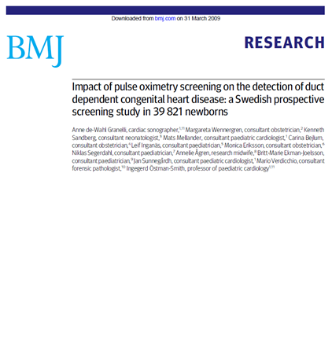
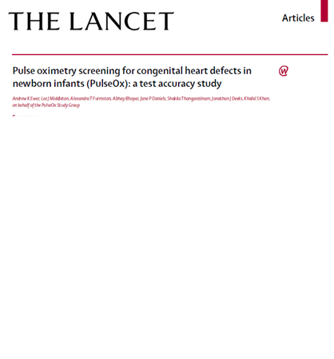
Both studies used pre/post ductal saturations

Slide 30
Both studies used pre/post ductal saturations
Granelli
Both <95% or
pre/post diff >3%
2 repeat tests for
borderline results
Screened after 24hours
Median age – 38 hours
Ewer
Either <95% or
pre/post diff >2%
Clinical assmt then 1 repeat
test for borderline results
Screened before 24hours
Median age – 12 hours

Slide 31
Both studies used pre/post ductal saturations
Granelli
Both <95% or
pre/post diff >3%
2 repeat tests for
borderline results
Screened after 24hours
Median age – 38 hours
Ewer
Either <95% or
pre/post diff >2%
Clinical assmt then 1 repeat
test for borderline results
Screened before 24hours
Median age – 12 hours

Slide 32
Both studies used pre/post ductal saturations
Granelli
Both <95% or
pre/post diff >3%
2 repeat tests for
borderline results
Screened after 24hours
Median age – 38 hours
Ewer
Either <95% or
pre/post diff >2%
Clinical assmt then 1 repeat
test for borderline results
Screened before 24hours
Median age – 12 hours

Slide 33
Both studies used pre/post ductal saturations
Granelli
Both <95% or
pre/post diff >3%
2 repeat tests for
borderline results
Screened after 24hours
Median age – 38 hours
Ewer
Either <95% or
pre/post diff >2%
Clinical assmt then 1 repeat
test for borderline results
Screened before 24hours
Median age – 12 hours

Slide 34
Both studies used pre/post ductal saturations
Granelli
Both <95% or
pre/post diff >3%
2 repeat tests for
borderline results
Screened after 24hours
Median age – 38 hours
Ewer
Either <95% or
pre/post diff >2%
Clinical assmt then 1 repeat
test for borderline results
Screened before 24hours
Median age – 12 hours

Slide 35
Granelli - sensitivity 62%, FP rate 0.17%
Ewer - sensitivity 75%, FP rate 0.8%
✔

Slide 36
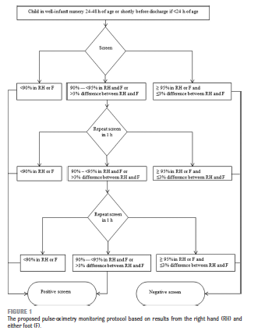
US PO screening algorithm

Slide 37
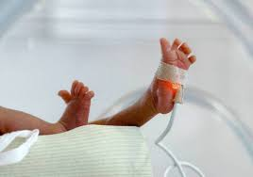
What is the best PO
screening algorithm?

Slide 38
Screening algorithms
Pre and post or post ductal only?
Early or late screening?
Most sensitive thresholds for screening algorithm?

Slide 39
Pre and post-ductal vs Post-ductal
No difference in sensitivity in meta-analysis
Pre/post consistently identifies CCHD which would have been missed by post-ductal only
Granelli – 1 CCHD
Ewer – 3 CCHDs
Equivalent to 7 CCHDs per 100 000 births
4M births in USA ➔ up to 280 CCHDs missed

Slide 40
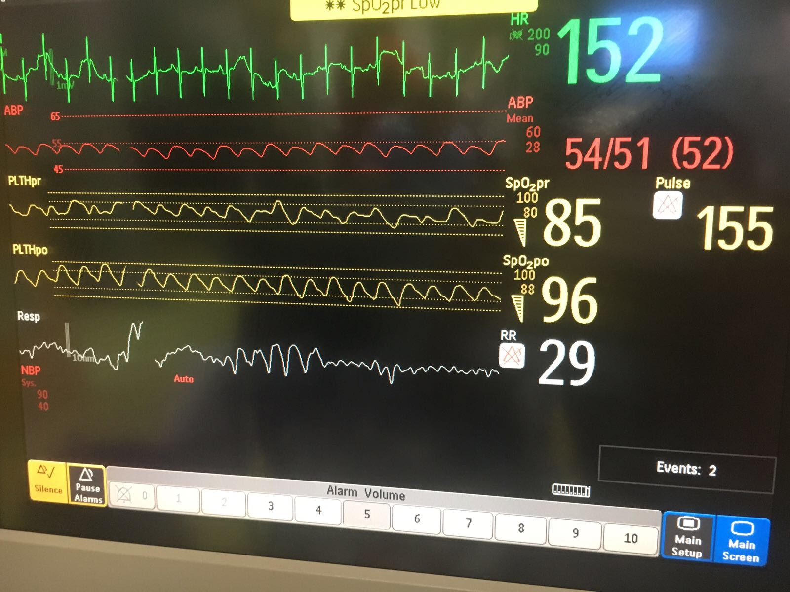
TGA with hypoplastic arch

Slide 41
Pulse oximetry screening
Rationale
Hypoxaemia (low saturations) present in the majority of critical CHD (CCHD)
Frequently clinically undetectable
Pulse oximetry may detect babies with CCHD early, before they collapse
Also detects other hypoxaemic conditions e.g. pneumonia, PPHN, sepsis

Slide 42
Pulse oximetry screening
Rationale
Hypoxaemia (low saturations) present in the majority of critical CHD (CCHD)
Frequently clinically undetectable
Pulse oximetry may detect babies with CCHD early, before they collapse
Also detects other hypoxaemic conditions e.g. pneumonia, PPHN, sepsis

Slide 43
Early or late screening
(<24 or >24hrs)
Most babies have ‘normal’ sats within 2 hr
FP lower if PO screening >24 hr
(0.05 - 0.11%) vs. (0.47 - 0.5%)

Slide 44
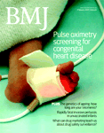
False positives
High false positive rate with PulseOx study
- earlier screening
- conservative threshold
Granelli* FP rate 0.17% vs 0.8% (sens 62% vs 75%)
- screened later 38 vs 12 hrs
However in Granelli’s study…
28/57 CCHD presented before screening
‘Collapse’ in 11/57 (19%) [incl. 6 in hospital]
c.f. 1/26 (4%) in PulseOx [0 in hospital]
*Granelli et al BMJ 2009;338:A3037

Slide 45
CCHD presenting before screening
Later screening studies report 50% of CCHD babies presented before screening^{1,2}
Up to 10% present with collapse in hospital ¹
Granelli BMJ 2009
Riede EJP 2010

Slide 46
CCHD presenting before screening
’The concept of timely diagnosis… defined as occurring in hospital and in time to prevent severe acidosis before the diagnosis is made.
Thus patients discharged with duct dependent circulation without diagnosis and patients who collapsed in hospital without diagnosis would not be considered to have had a timely diagnosis.
With these criteria, we found absence of timely diagnosis of duct dependent circulation in 45/100 (45%) of patients in [non – PO] regions compared with 11/60 (18%) of patients in [PO regions].’¹
Granelli BMJ 2009

Slide 47
CCHD presenting before screening
‘The ideal way of optimising number of timely diagnoses is probably to have one pulse oximetry screening during the first 24 hours of life to prevent circulatory collapse in hospital of babies with duct dependent [CCHD].¹’
Granelli BMJ 2009

Slide 48
Non-cardiac conditions
Pneumonia, sepsis and PPHN all more likely to present in first 24 hours (false positives)
Although not target conditions a baby is just as likely to die from undiagnosed sepsis as undiagnosed CCHD

Slide 49
CCHD presenting before screening
New Jersey experience – 2011-2012
72 694 babies screened – 3 CCHDs identified¹
Not specified, but likely many CCHDs presented before screening (70-140 CCHD expected)
Garg et al Pediatrics 2013

Slide 50
CCHD presenting before screening
New Jersey experience – 2011-2014
327 447 babies screened
Test positive n=133
CCHD n=25 Other medical conditions n=10
Test positive rate = 0.04%
Estimated CCHD prevalence 327 – 654
Garg et al Pediatrics 2013 and unpublished data

Slide 51
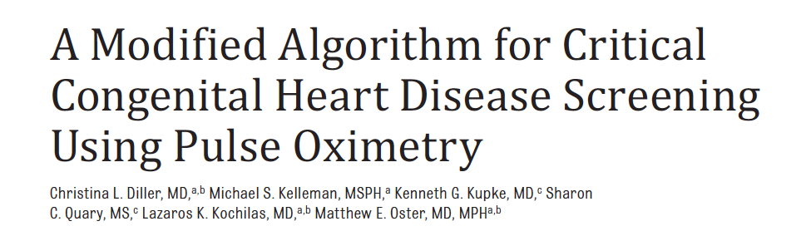
>77 000 babies screened
Only 1 case of CCHD detected
(Estimated CCH prevalence 77-154 cases)
Only 10 cases of non-CCHD illness

Slide 52
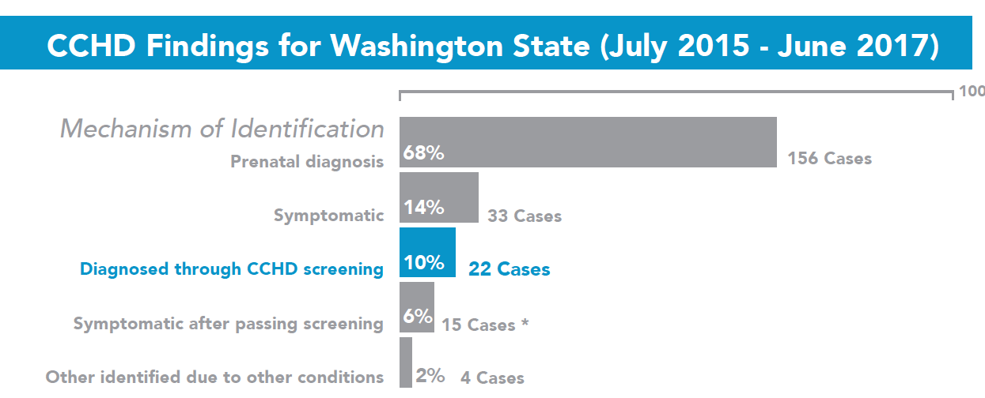
How many babies are presenting with
collapse prior to diagnosis?

Slide 53
Death from CCHD in 1st 24 hours not analysed
Are babies with first day collapse being missed?

Slide 54
Early screening (<24 hours)
Will reduce the risk of first day collapse…
… both from undiagnosed CCHD
and other potentially lethal conditions
such as GBS sepsis
But… the FP rate will be higher

Slide 55
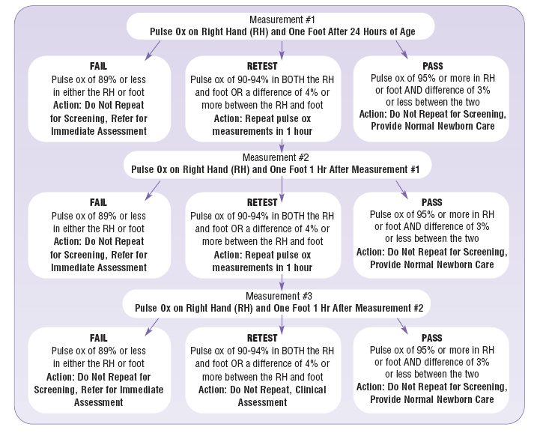
US algorithm
But… there are variations

Slide 56
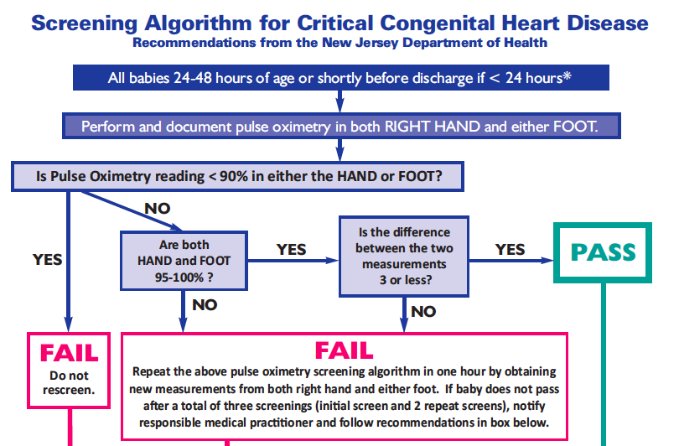

Slide 57
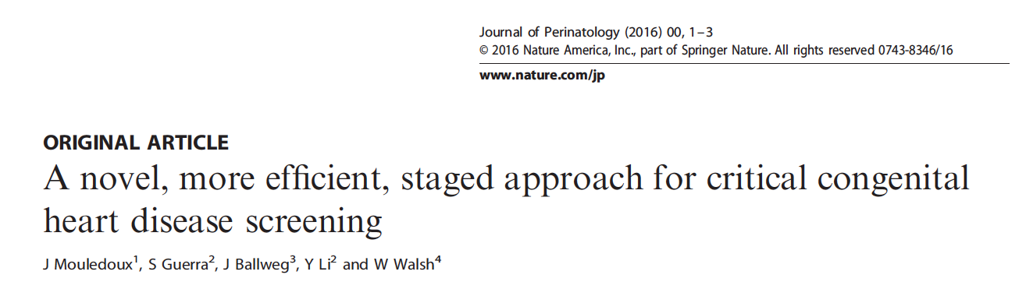
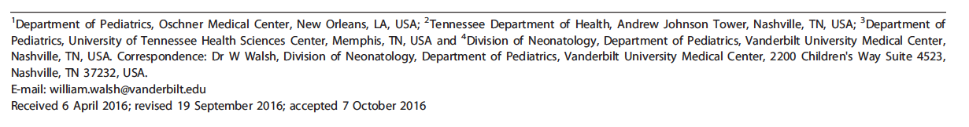
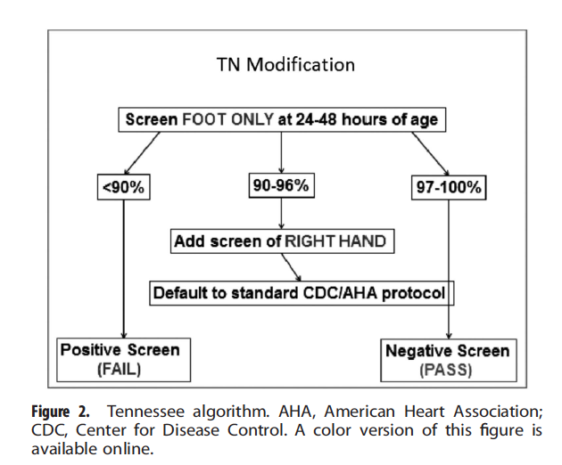

Slide 58
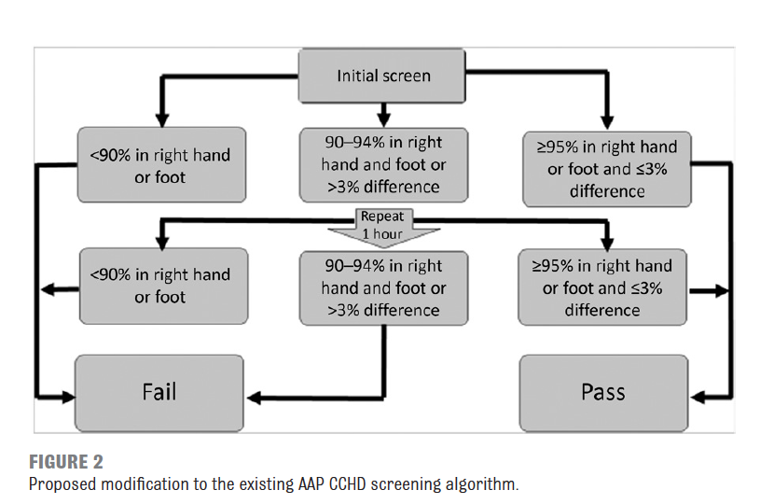

Slide 59
Comparison of algorithms
US ‘Granelli’ algorithm
UK ‘PulseOx’ algorithm
US – screen >24 hours
pre/post both <95%
diff >3%
90-94% - 2 repeats then assmnt
PulseOx - screen <24hours (6-8)
pre/post either <95%
diff >2%
90-94% clinical assmnt and 1 repeat

Slide 60
Pre/post either or both <95%
Clinical conundrum (1)
Sats - post 92%

Slide 61
Pre/post either or both <95%
Clinical conundrum (1)
Sats - pre 95% and post 92%
US algorithm - Pass
Post-ductal algorithm - Retest
UK algorithm - Retest

Slide 62
Clinical conundrum (2)
First sats - pre 98%/post 94%
US algorithm - Retest
Post-ductal algorithm - Retest
UK algorithm - Retest

Slide 63
Clinical conundrum (2)
Retest sats - pre 97%/post 93%
US algorithm - Retest
Post-ductal algorithm - Fail
UK algorithm - Fail

Slide 64
Clinical conundrum (2)
2nd Retest Sats - pre 95%/post 92%
US algorithm - Pass
Sats - 98/94 ➔ 97/93 ➔ 95/92

Slide 65
Pre and post-ductal difference
>3% (Granelli, Sweden)
FP rate 0.17%, sensitivity 62%
>2% (Ewer, UK)
FP rate 0.8%, sensitivity 75%
2 CHD (1 critical) identified by >2% alone.
More evidence may come from national datasets
Notes:
Which is best? Very low FP rate or detecting babies with severe illness before they collapse?

Slide 66
Repeat testing
Repeat testing without prior assessment may delay the identification of a sick baby
Notes:
Which is best? Very low FP rate or detecting babies with severe illness before they collapse?

Slide 67
False negatives
Not a perfect test, but better than existing
Will miss approximately 20 - 25% of CCHD
Commonest defects missed – CoA, IAA
Ewer – 43% (3/7)
Zhao – 42% (5/12)
Turska−Kmieć – 33% (1/3)
Granelli – 21% (3/14)
Riede – 0% (0/2)

Slide 68
There are insufficient data (from only
60 000 screened babies) to precisely define the most sensitive algorithm
UK algorithm has the potential to detect more babies at expense of higher FP rate

Slide 69
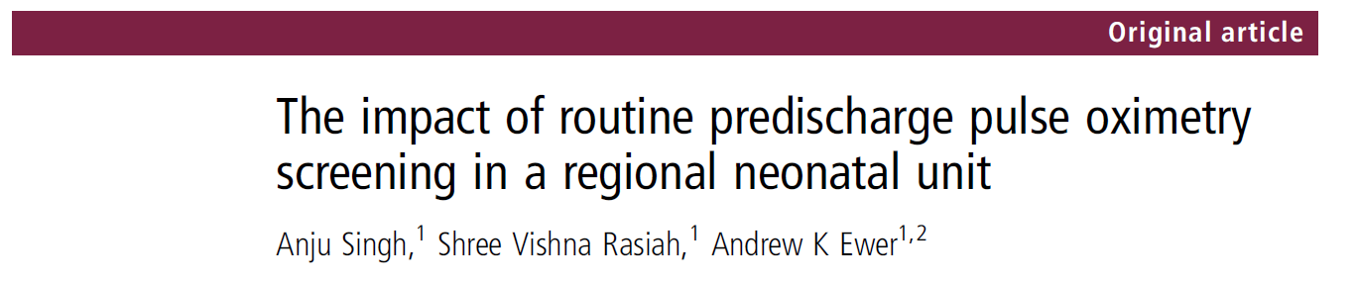
BWH screening programme
2010-2013 (40 months)
Notes:
Our experience in UK Birmingham Women’s Hospital

Slide 70
Total Livebirths: 25 859
Most babies screened <12 hrs (mean age 7 hrs)
Test positive pulse oximetry: 208
0.8% of all livebirths - Just >1 admission a week
Congenital heart defects identified: 17
  Critical CHD: 9
  Serious CHD: 3
  Significant CHD: 5
  2 CCHD missed by all screening procedures
Singh, Rasiah, Ewer Arch Dis Child FN 2014;99:F297-F302.

Slide 71
Other significant diagnosis
  Congenital pneumonia: 55
  Sepsis: 30
  PPHN: 12
  MAS: 4
  TTN requiring oxygen: 41
  Pneumothorax 3
Congenital Pneumonia- ↑inflam markers ± +ve culture, X-Ray changes, O2 requirement, abs ≥ 5 days.
Sepsis - ↑ inflammatory markers ± culture +ve, abs ≥ 5 days
MAS – h/o meconium , respiratory distress, O2 requirement, X-Ray changes
TTN requiring oxygen: Tachypnoea with X-Ray changes of fluid retention, oxygen requirement, no rise in inflam markers or +ve culture
Notes:
How many had positive cultures?

Slide 72
Results
Transitional circulation/mild TTN: 43 (21%)
No collapse in the postnatal wards
Echos performed for test +ve pulse Ox:
61/208 (29%)
Abnormal Echos: 29/61 (48%)

Slide 73
Murmurs and echocardiography
3 year data from Birmingham Women’s Hospital
205 echos for babies with murmur
123 (60%) no significant abnormality
72 (35%) septal defects
2 (1%) CCHD – 1 CCHD/100 scans
[PulseOx 9/61 (15%) CCHD] – 1 CCHD/6.5 scans
Singh A et al. Acta Paed 2012;101:1651-2227.

Slide 74
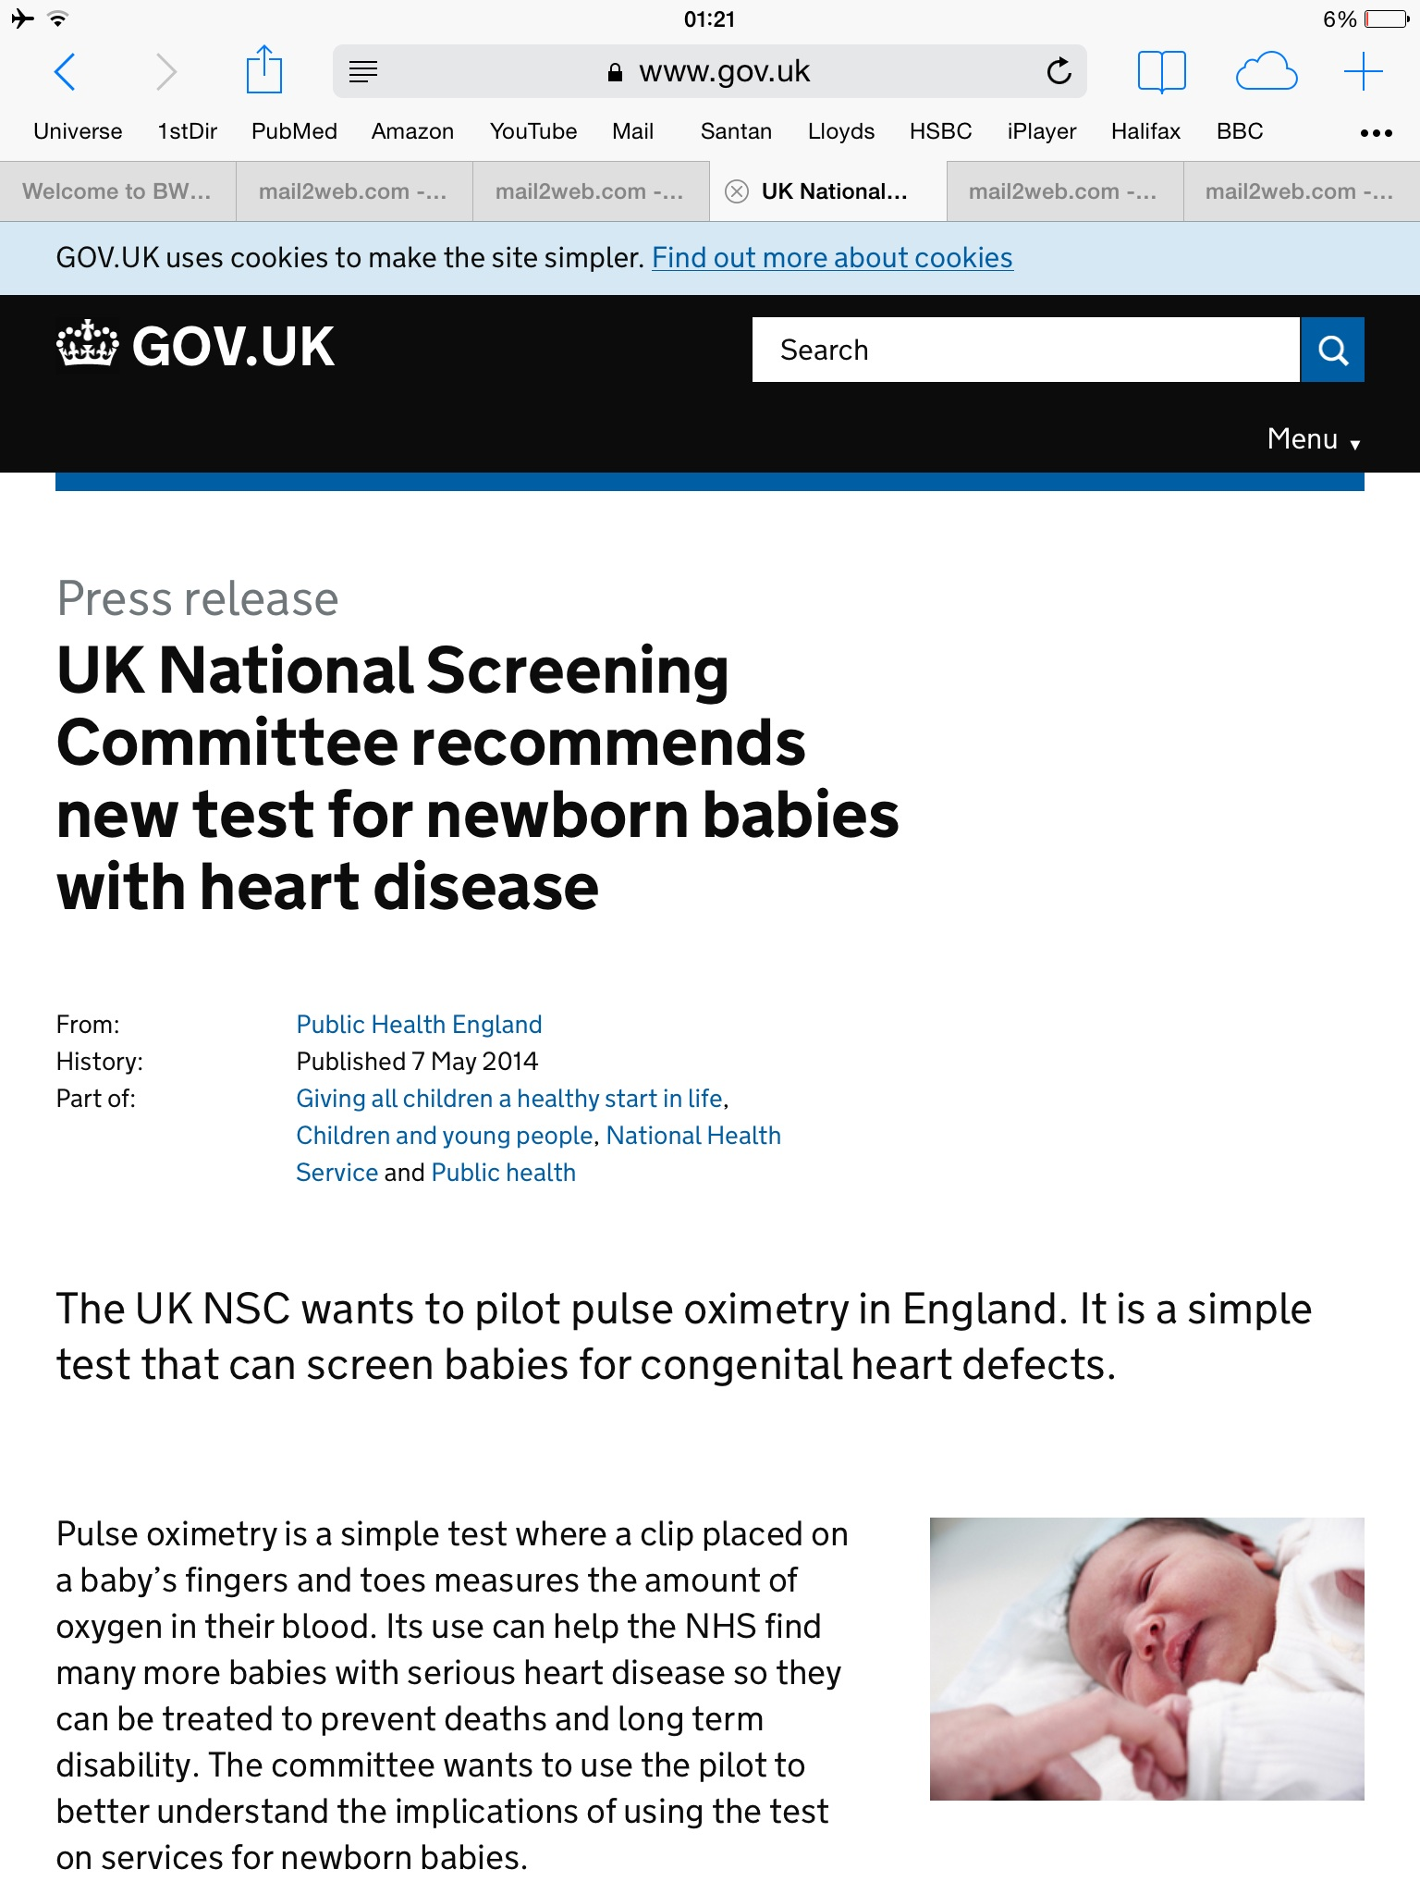

Slide 75

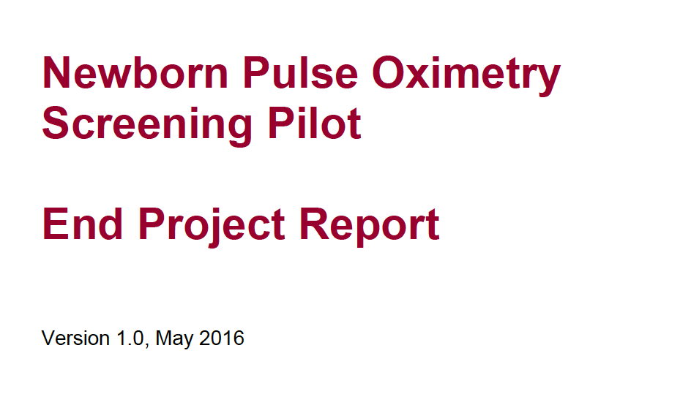

Slide 76
UK pilot
32 836 babies screened
239 test positives (0.73%)
14 CHD (8 CCHD) – [2 FNs]
82 significant non-cardiac disease

Slide 77
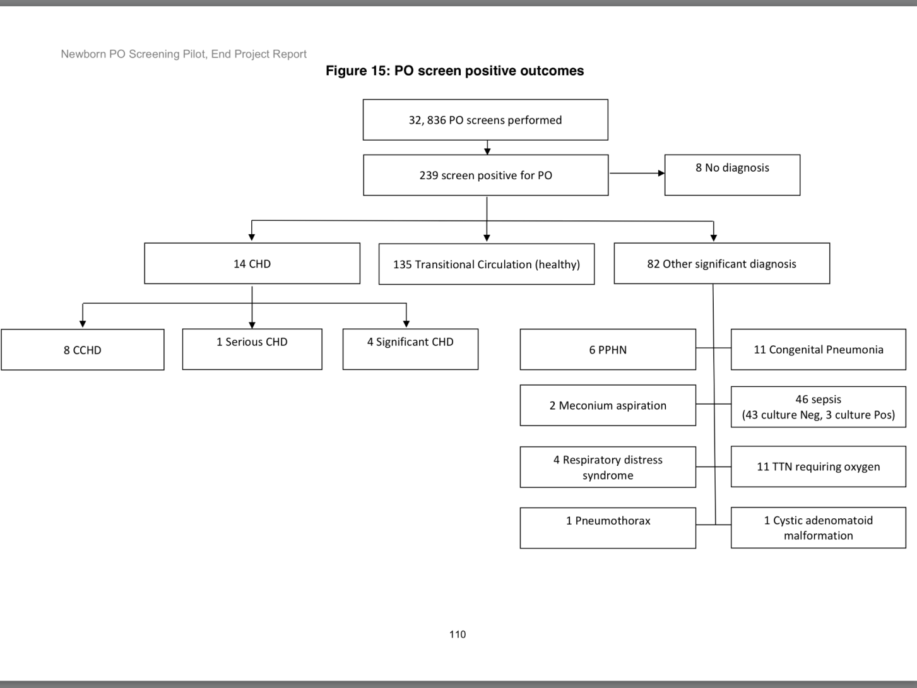
Screen positive outcomes

Slide 78
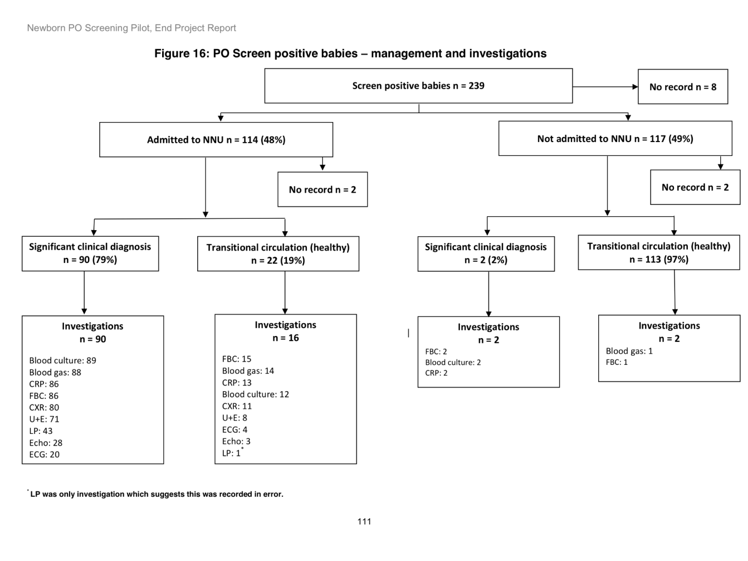
Screen positives – Management and Investigations

Slide 79
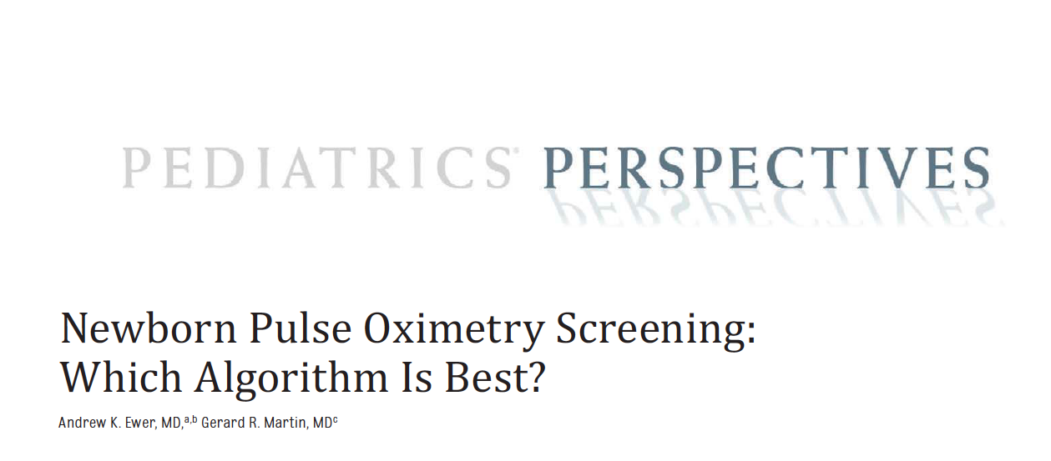
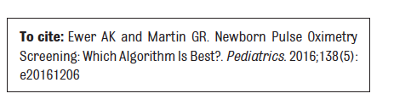

Slide 80
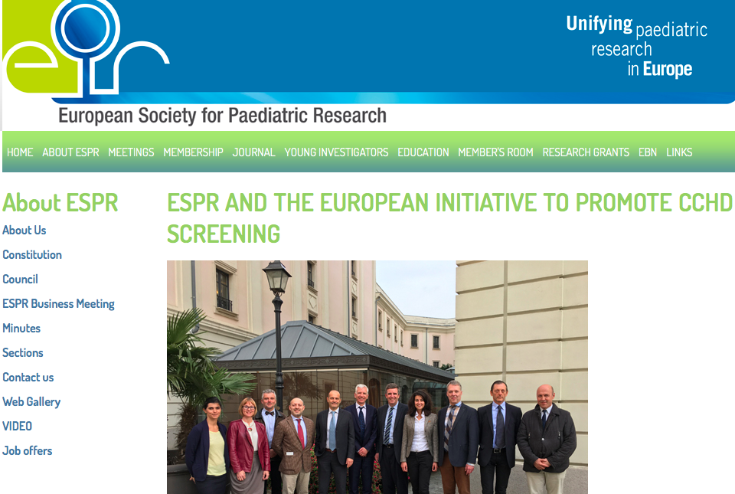
Milan 2016

Slide 81
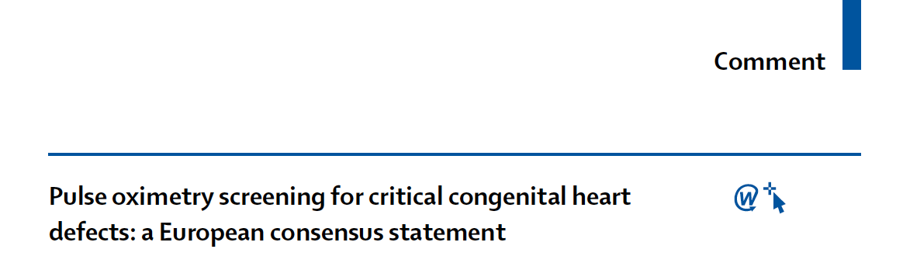

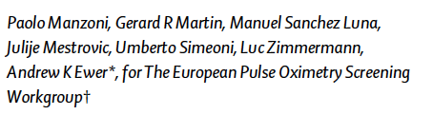
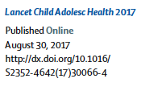


Slide 82
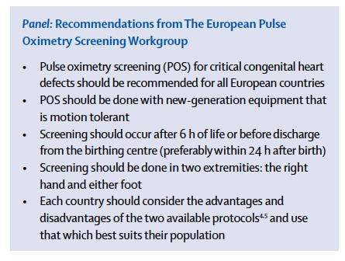

Slide 84
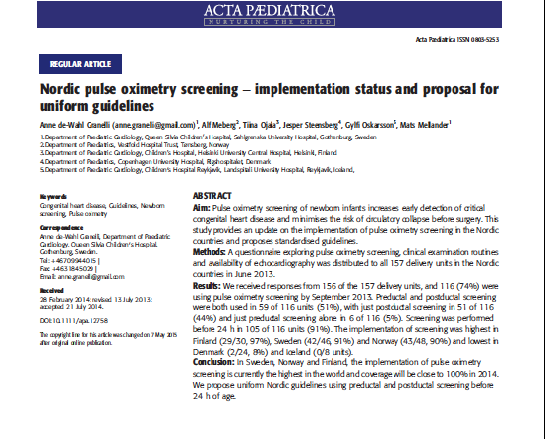

Slide 85


Slide 86

NSC Workgroup meeting 22nd June 2018

Slide 87
Summary
Pulse oximetry with any algorithm reduces the diagnostic gap for CCHD and saves lives.
Early (<24 hours) and pre/post ductal screening has potential advantages with sl. higher FP rate
More pre/post data from large populations needed for precise sensitivity modelling

Slide 88
Final thought
Which is better…?
detecting more babies with significant illness before they become unwell (at the expense of a moderately higher FP rate), or a test with a very low FP rate which detects relatively few ill babies?
a.k.ewer@bham.ac.uk

