Slide 1


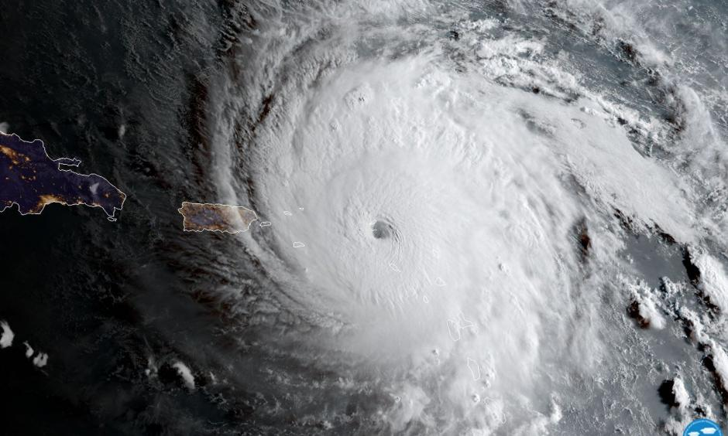
NBS Follow-up after Hurricane Maria: Experience of the Puerto Rico Program
University of Puerto Rico
Medical Sciences Campus
School of Medicine
Department of Pediatrics
PR
Dr. Sulay Rivera-Sánchez
Associate Director
October 22, 2018
Short Term Follow Up National Webinar

Slide 2
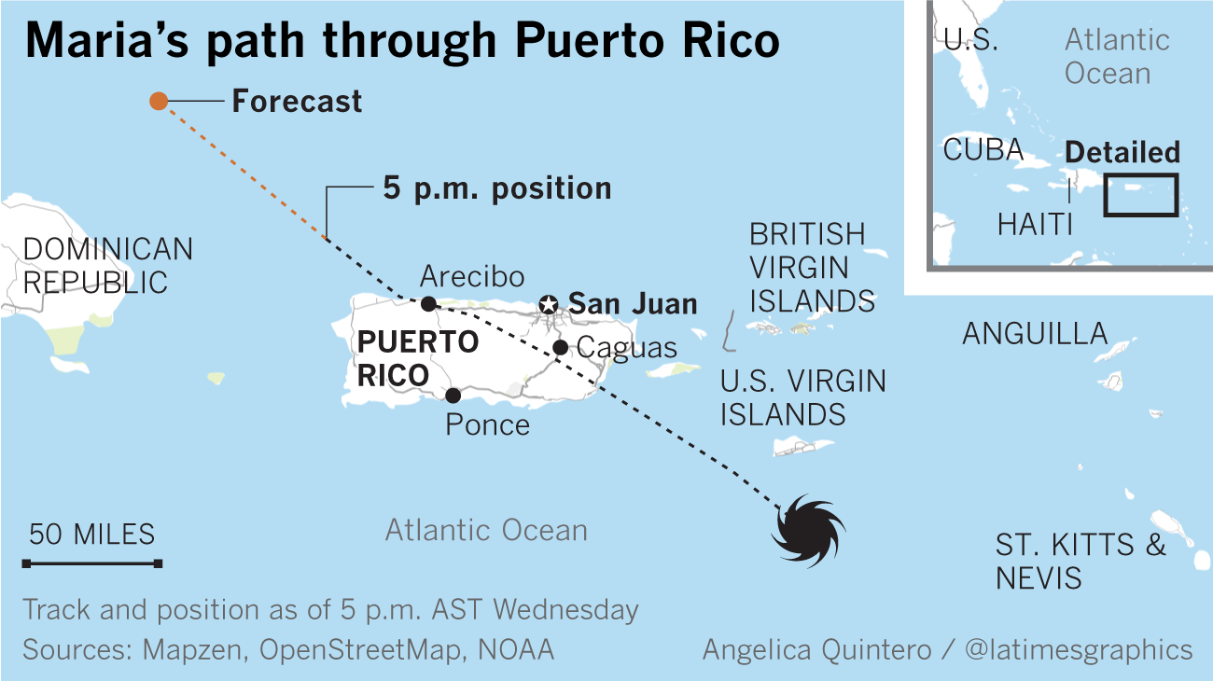
Hurricane Maria: September 20, 2017
Obtained from Los Angeles Times
Notes:
Sept 20 PR was hit by one of the most powerful hurricanes of our history. This hurricane Cathegory 5 passed through the middle of our island causing unprecendented damage. Also important to mention two weeks earlier PR was also hit by Hurricane Irma.

Slide 3
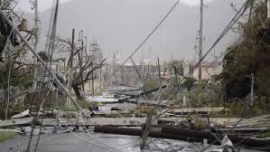
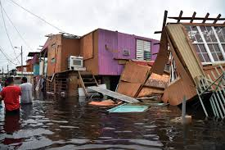
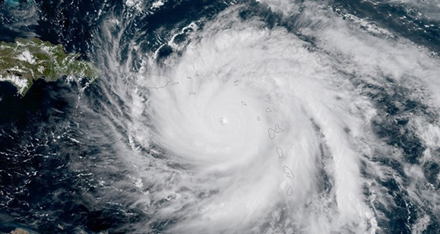
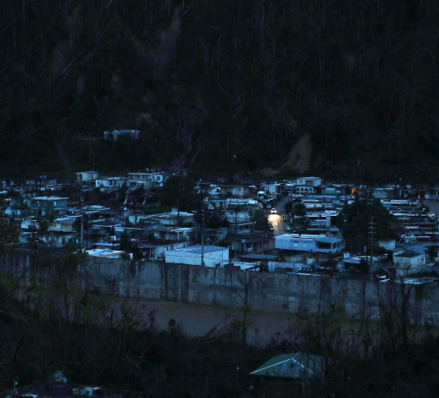
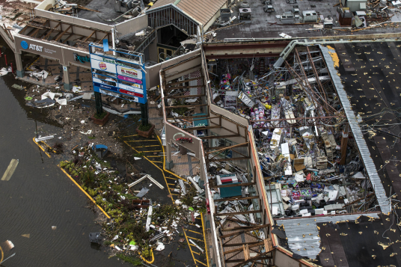
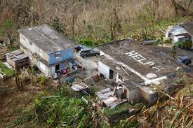
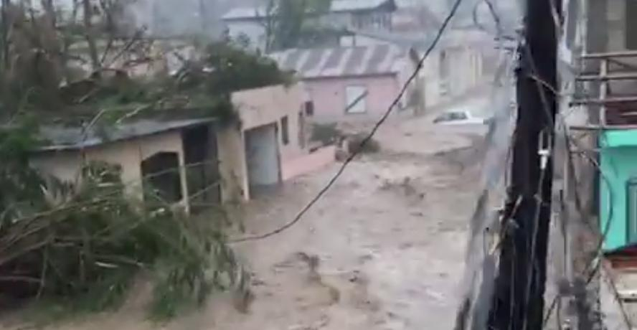
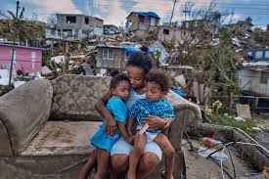
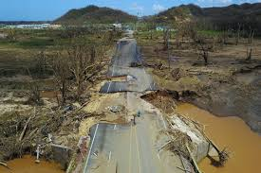
Hurricane Maria: September 20, 2017
Notes:
Some of the consequences of this hurricane were:
Complete destruction of houses and buildings specially those in wooden structures
Floods in different areas
Collapse of the power system
Loss of communication; After the hurricane just one radio station was operational
Scarcity of food, water, gas
Destruction of roads and isolation of some residents
Families that lost everything; Many that lost their jobs; In general the poor and vulnerable people were the most affected

Slide 4
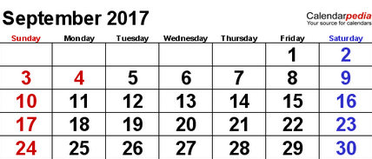
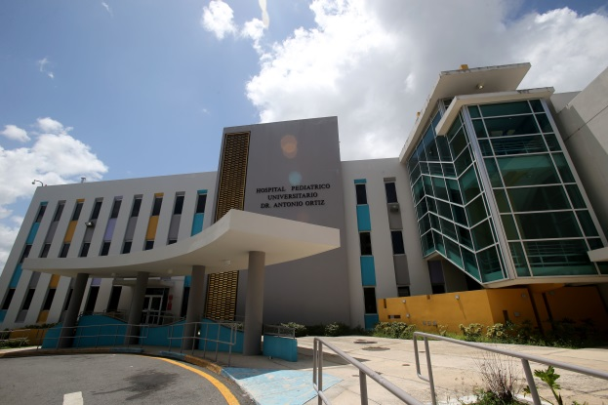
After the hurricane…….
What we found?
The building and our facilities (cement-based) suffered minor damages.
Water
Power (no stable)
Internet (no stable)
One telephone line (with some occasional problems but working)
Health information system available
Reduced personnel available
No major damages so we were ready to continue saving babies!!
An old air conditioner fell from the wall.
Some water came in through the windows.
Localized in the University Pediatric Hospital at San Juan Medical Center

Slide 5
Impact on PR NBS Service

Slide 6
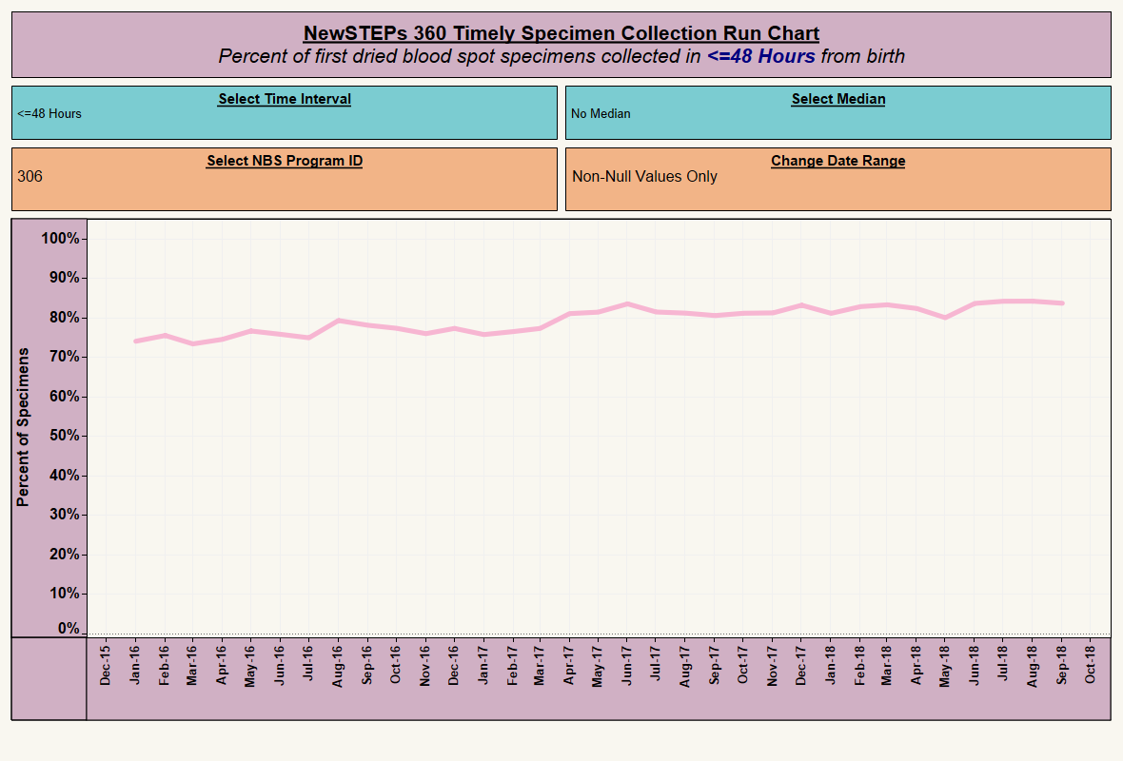
Age of Sample Collection
Obtained from NewSTEPS website

Slide 7
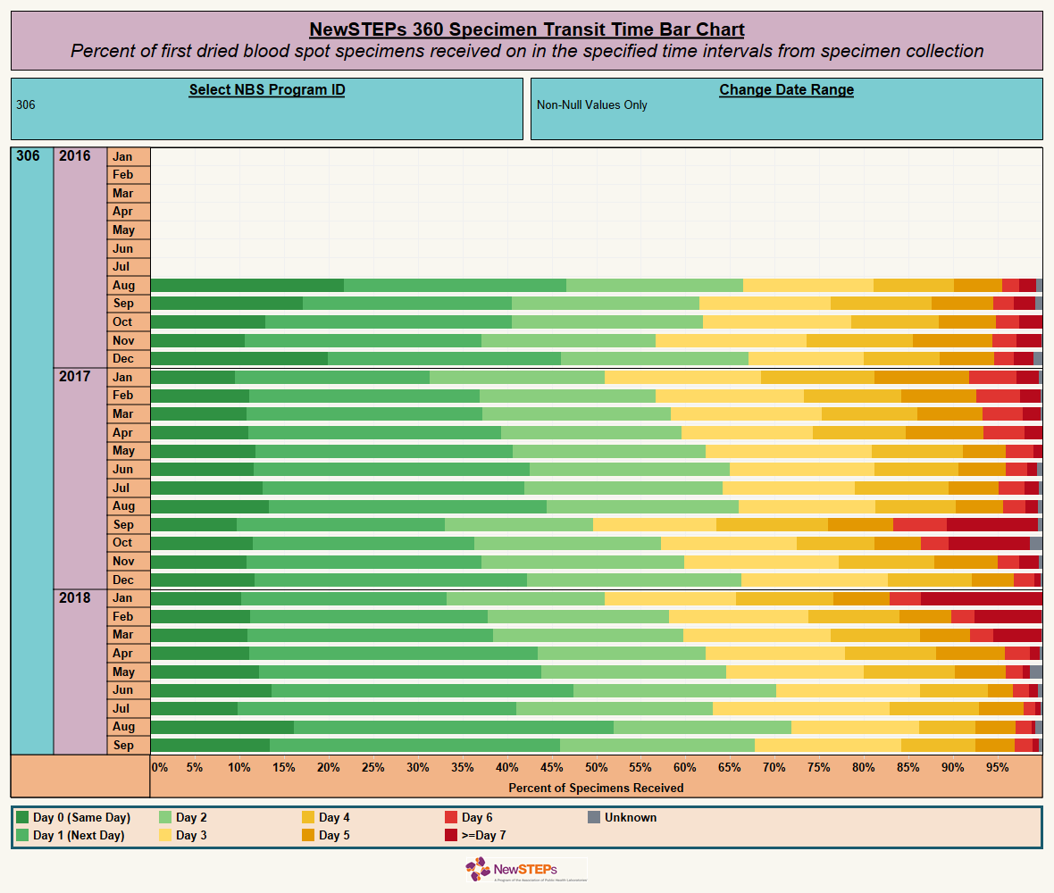
Transit Time
Obtained from NewSTEPs website

Slide 8
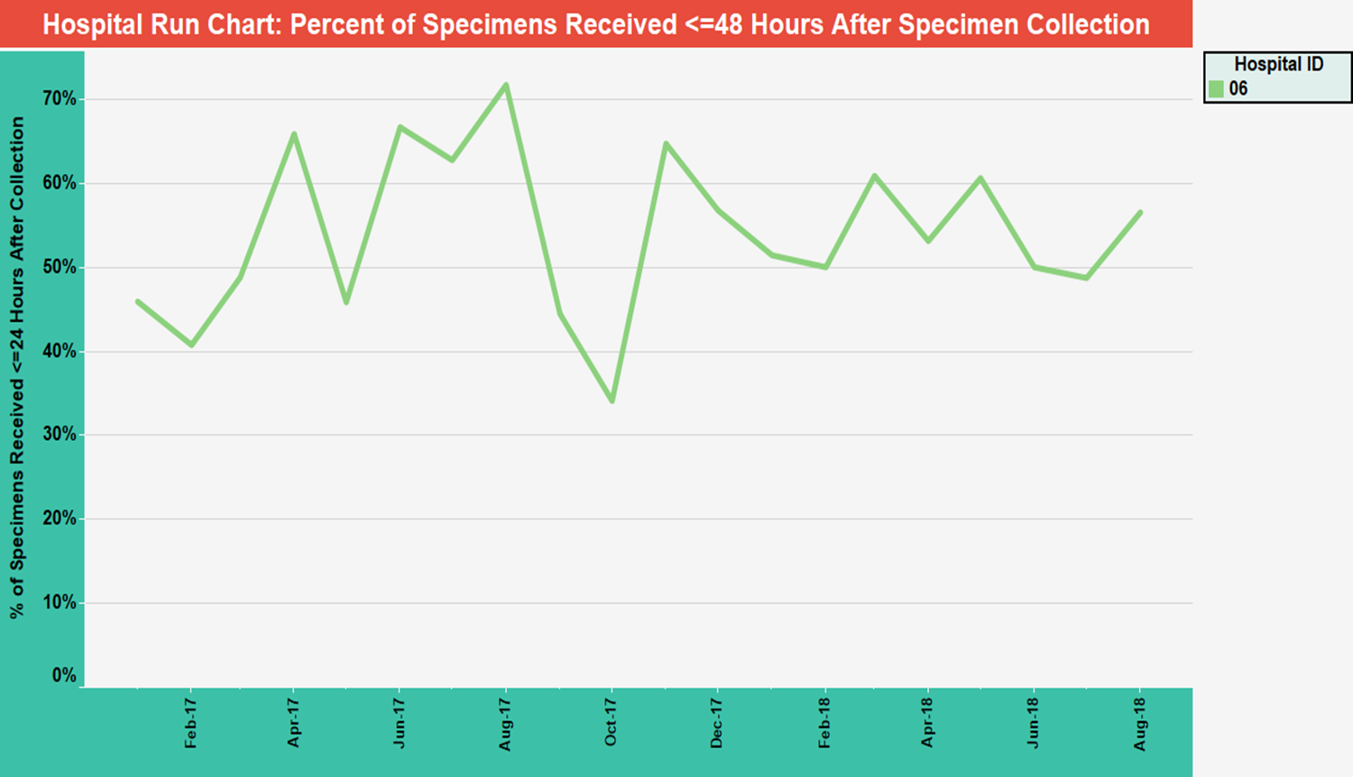
Obtained from NewSTEPs website

Slide 9
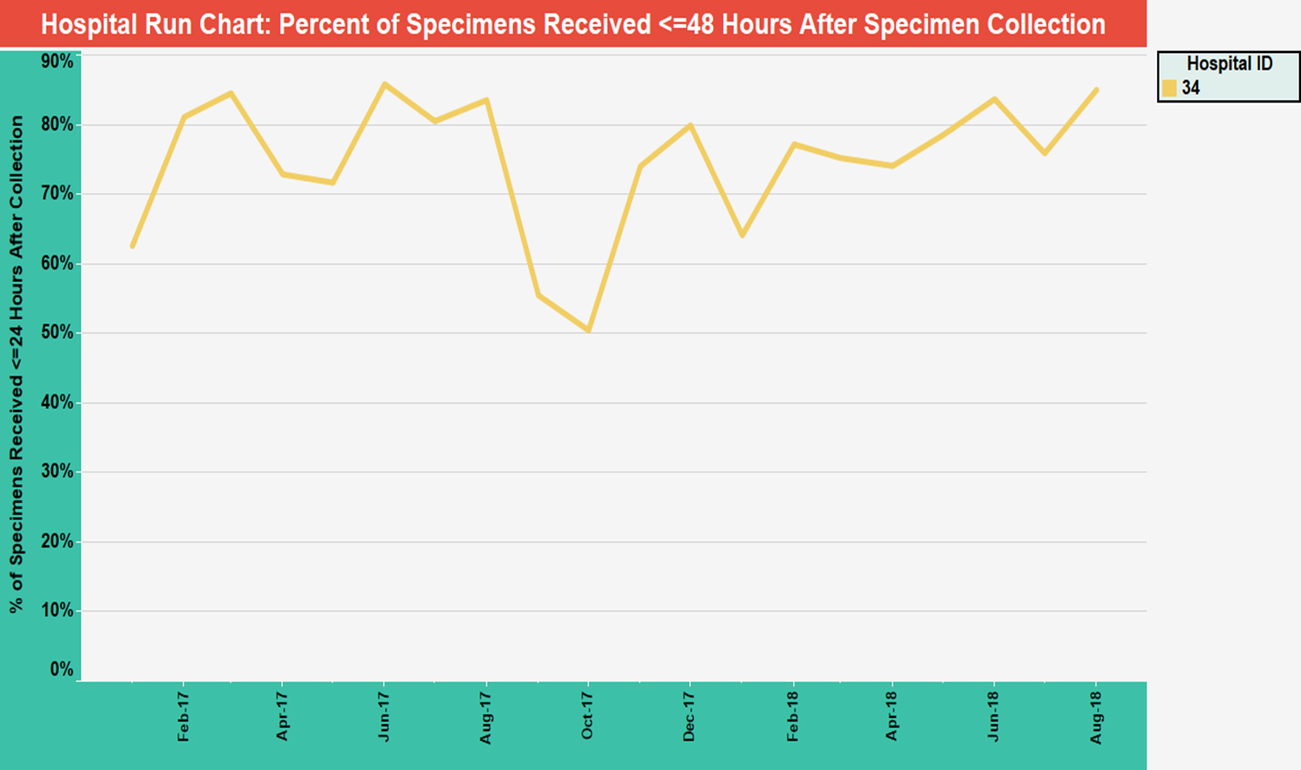
Obtained from NewSTEPs website

Slide 10
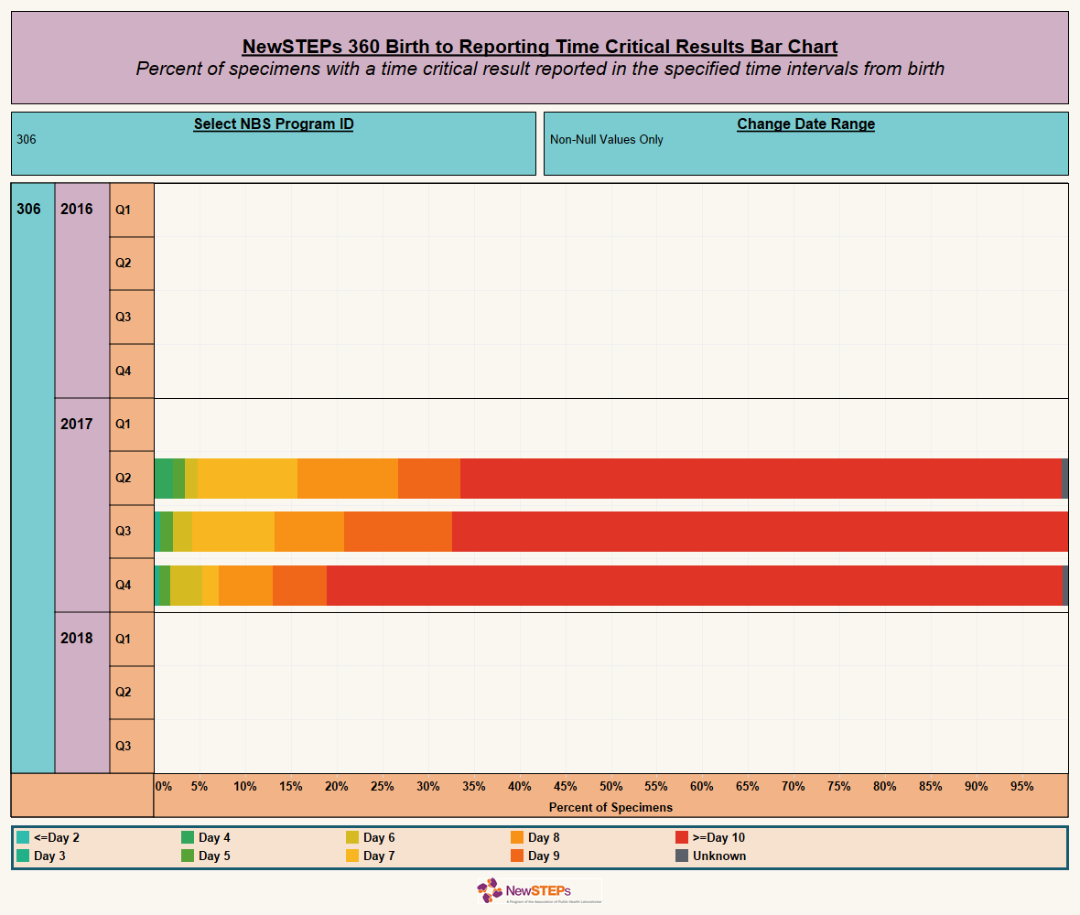

Time to report out results
Obtained from NewSTEPs website

Slide 11
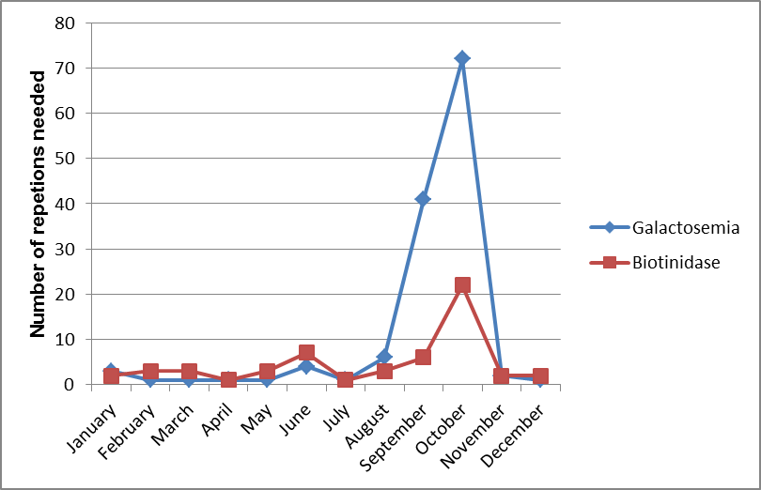
Repeats
Increase in the number of repetitions for some tests
      Aged samples
      Not adequate storage of samples

Slide 12
Follow-up
Situation:
NO communication in our country
Increase in the number of repetitions needed for some tests
We were running with a delay
24 presumptive positive cases were identified the next weeks after Maria
Strategies to find families:
Social media (facebook)
Police
List of cases sent to hospitals
Volunteers from different municipalities
Mail office
Text messages sent by our Follow-up staff during the day and night
WhatsApp Groups
Department of Pediatrics
Government Offices and Churches
Our Follow-up supervisor visited two families to inform the results and bring the newborn to evaluation
2017
36 Confirmed Cases
39% identified after Maria
5 Metabolic Diseases
5 SCD
3 CH
1 BIOT Deficiency
All cases were efficiently managed with no consequences on newborns.

Slide 13
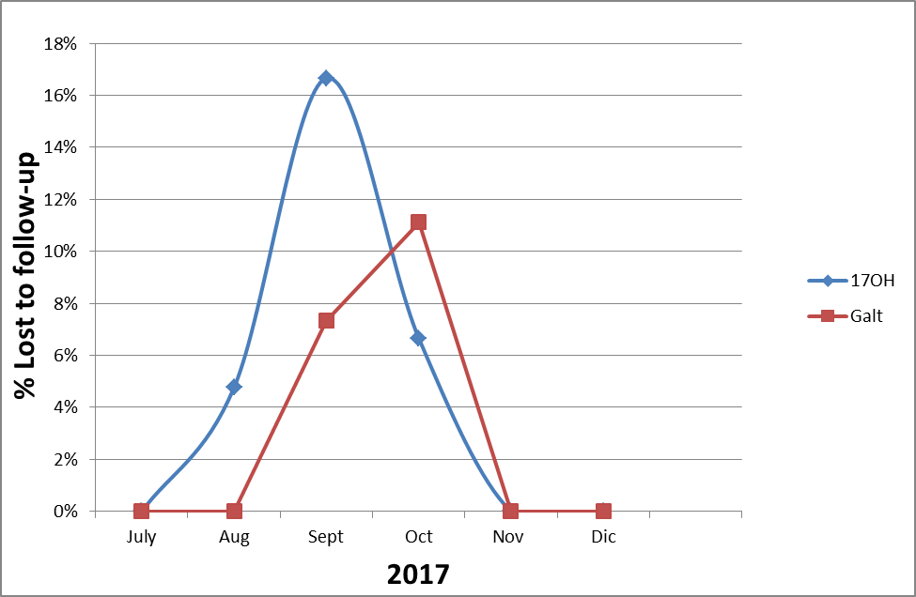
Lost to follow-up

Slide 14

Emergency Preparedness for Newborn Screening
Laboratory
  Service contract with other laboratory prior the emergency
Follow-up plan
Notes:
Under an emergency, no time for contracts, POs, you need to have a back-up plan already established

Slide 15
Lessons learned!!!
Every NBS Program need to have a back up plan to provide the service during an emergency. Ideally, a contract with other laboratory should be in place prior the situation.
Prepare for the worst, prepare for what you don’t expect.
    Evaluation of facilities
    No water
    No power; Is any backup power system available in your facility?
    No internet
    No communication with hospitals, families or healthcare providers
    Reduced personnel
    Birthing facility is not operational
    Problems with the delivery of samples
    No reporting system
Do back-up constantly
  Important files
  List of pending cases
  You can lose everything in an emergency
Identify the state agencies or community groups to contact who can provide help with the NBS service during the emergency
Have contact information of hospitals, neonatologists and pediatricians
Revise emergency plans and develop strategies considering different situations
    Discuss this plan with the staff and define roles

Slide 16
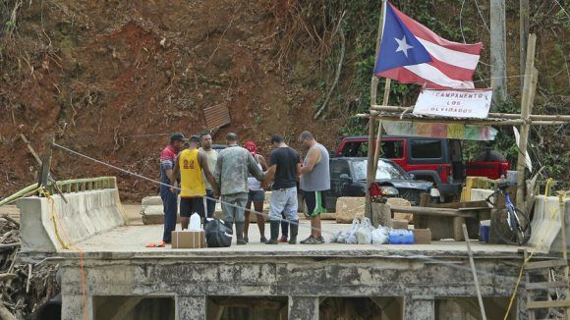
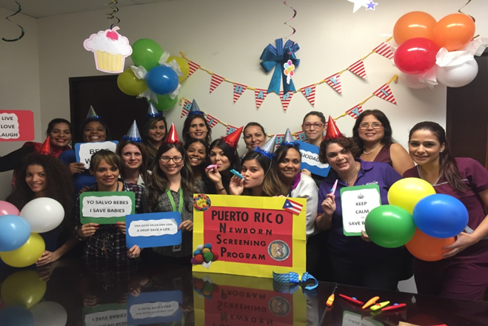
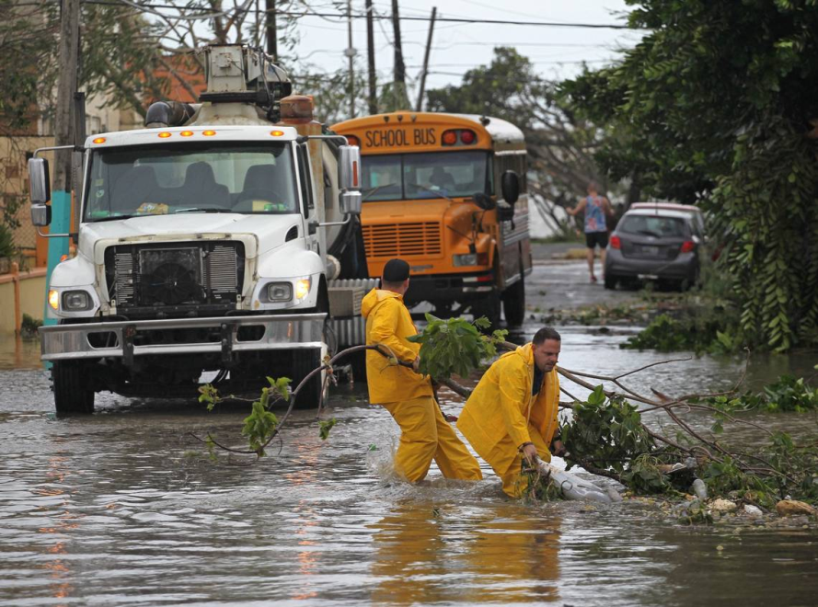
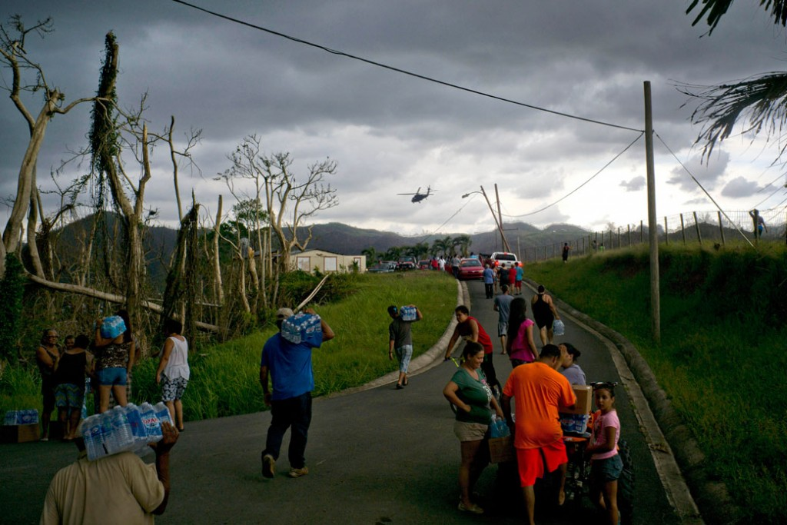
Commitment and Resilience!!
Notes:
Are the key words to describe what you need in an experience like Hurricane Maria.
the capacity to recover quickly from difficulties; toughness.

Slide 17
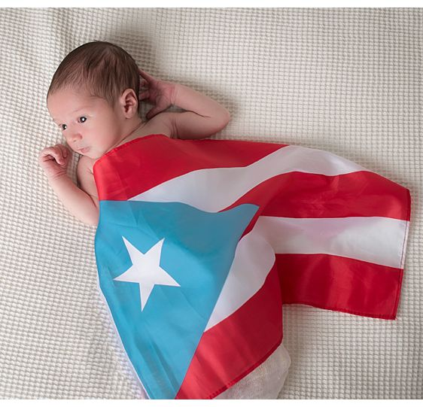
Thanks!!!
Notes:
APHL
CDC
NY NBS Program
NewSTEPs
Other NBS Programs
Some were resolved or for other presumptive positive, instructions were provided to family or pediatrician.
All the equipment was covered and if possible they were placed over counters (not left on floor).
Equipment was turned off (if possible), disconnected and/or protected with a battery system.
Materials and equipment next to windows were moved to another area.
The keys of our rooms were provided to the Administrative/Security staff of the hospital in case of an emergency. Instructions were also provided about areas with possible roof leaks or in which water could enter through the windows.
Instructions were given to the staff to do back up to important files
We evaluated all our pending patient cases.
Sample collection and delivery to NBS laboratory
Messengers from hospitals started to come that week to bring samples.
No sample rejected
Additional Contact Information was requested to hospitals
A letter was sent to hospitals with instructions for
sample collection and storage
Calls were made to the hospitals to inform that the NBS Program was operational and that we were waiting for the samples
CDC Hurricane Response Division contacted us and we reported them the hospitals that were not sending samples to evaluate their status.

