Slide 1
U.S.A. Implementation Roadmap:
Screening for Critical Congenital Heart Disease
Gerard R. Martin, MD
Medical Director, Global Services
C.R. Beyda Professor of Cardiology
Children’s National Health System
Abu Dhabi
2016
ACC Heart House
September 2018

Slide 2
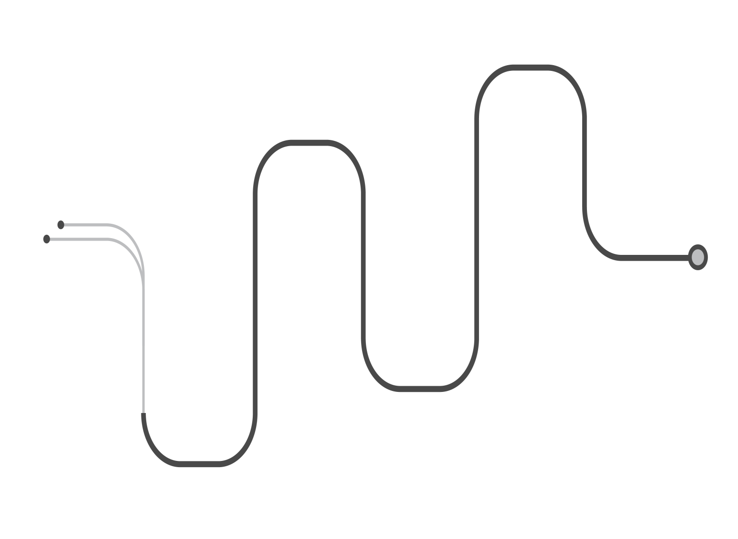



CCHD Roadmap
European Science
USA Science

Slide 3
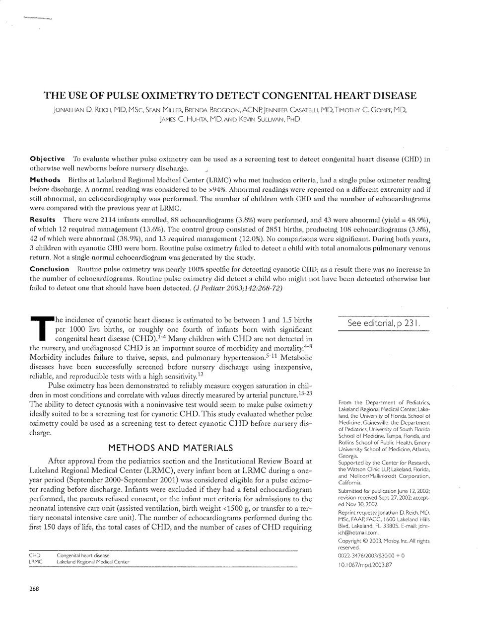
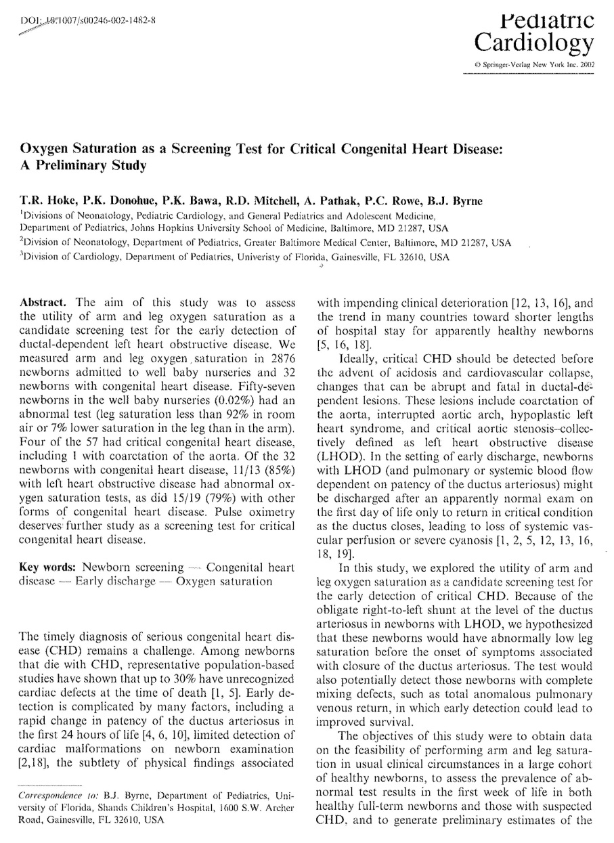
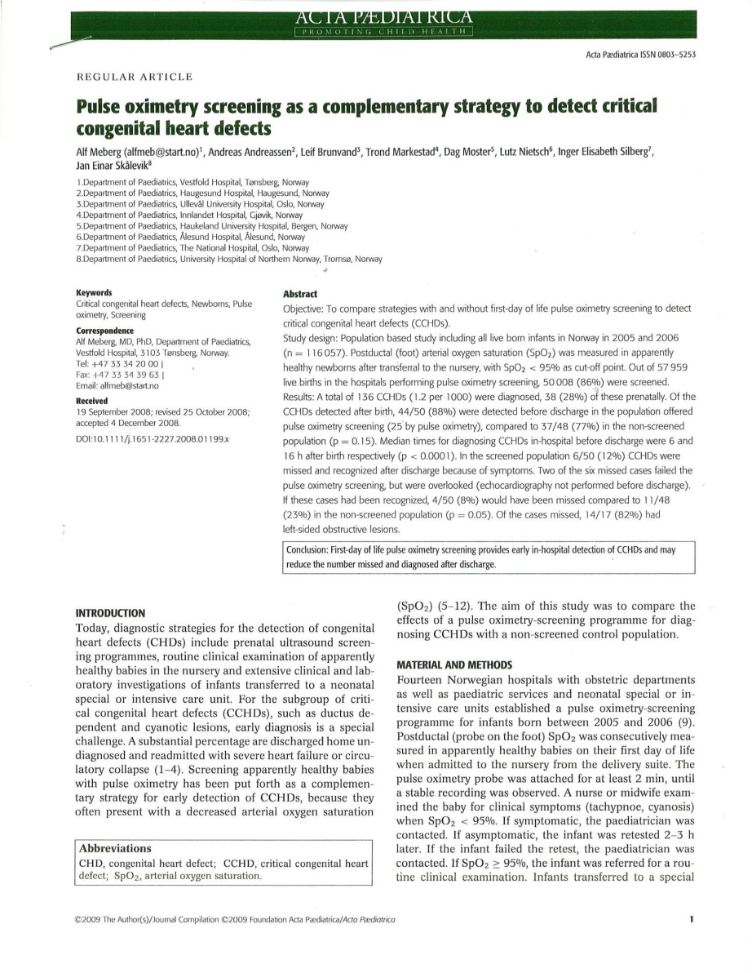
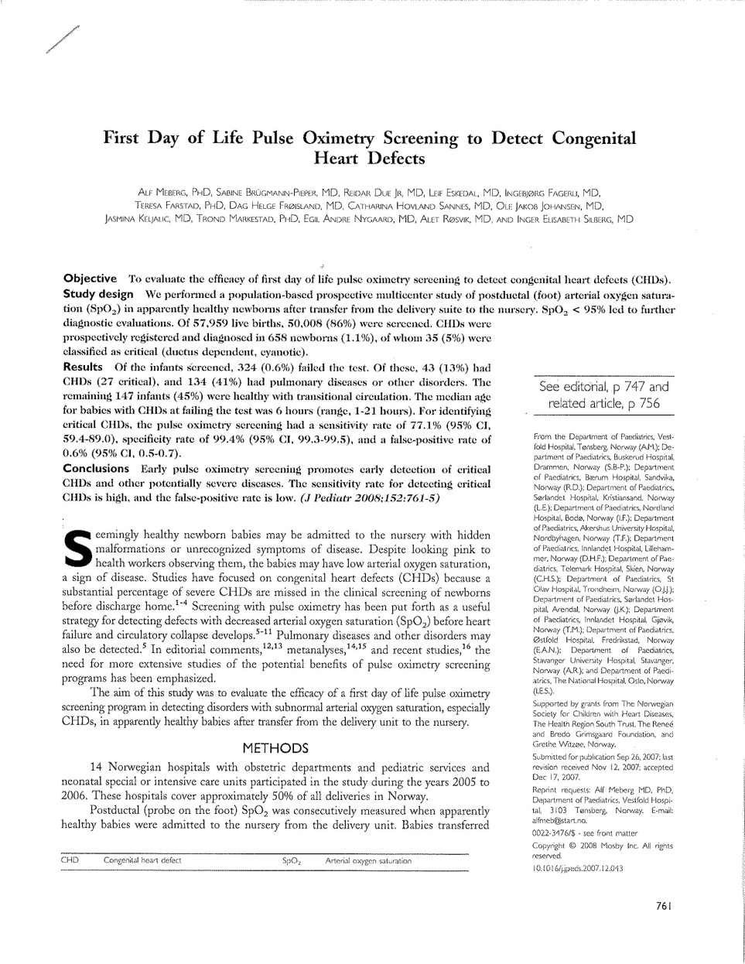
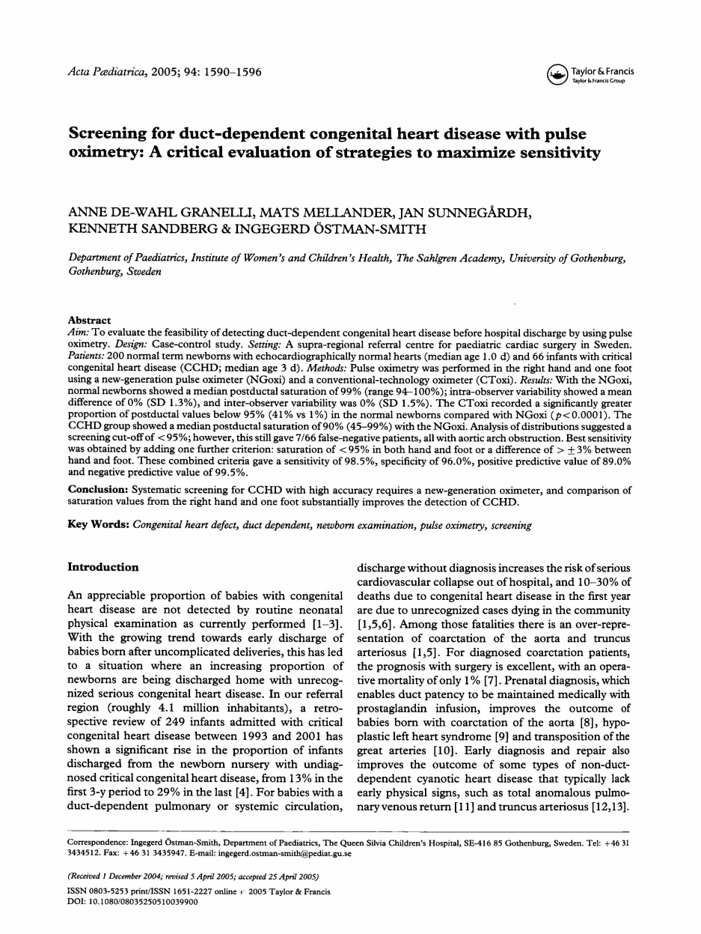
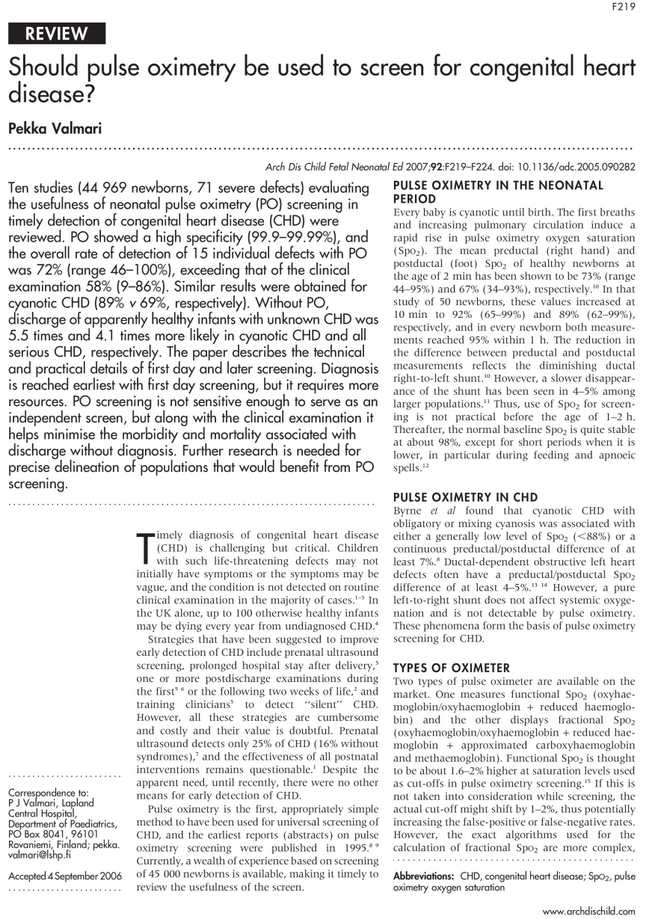
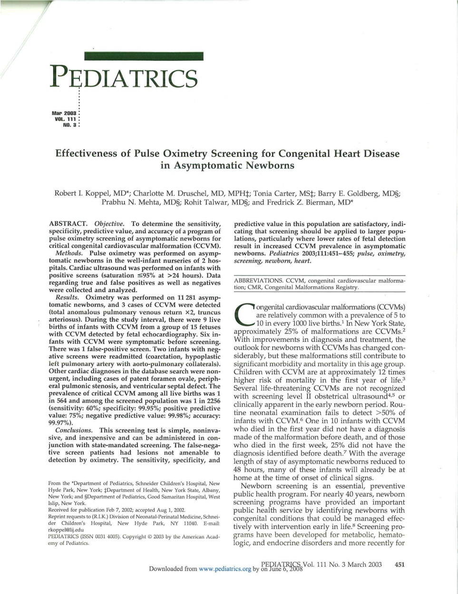
Early Science 2002-2007

Slide 4
CCHD Roadmap
European Science
USA Science
2009 AHA/AAP
Statement &
Granelli BMJ
338:2009

Slide 5
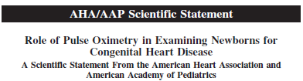
2009 Scientific Statement
Critical CHD is not detected in some infants
Failure to detect is associated with significant morbidity and occasional mortality
Pulse oximetry may detect critical CHD
Circulation 2009;120447-458
Notes:
5
In 1995..
In 2009, AHA AAP supported this position but felt we needed more population and implementation studies.

Slide 6
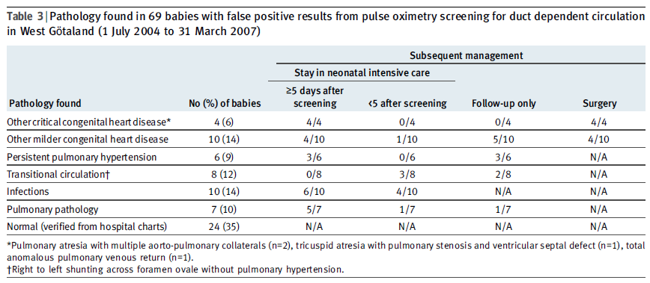
Granelli BMJ 338:2009
Notes:
6
Shortly after the AHA/AAP statement was released there were two impressive studies that just were published from a European experience. Granelli in Sweden looked at some 46,000 live births with pulse oximetry and compared strategy of PE alone with pulse ox alone with combination physical exam and pulse ox. Interesting results!
In addition to have an acceptable sensitivity and specificity, another interesting finding from this study had to do with the FPs that were detected. While the FPs were not CCHD, many of them true positive for other important pathologies… PPHN, Pneumonia, Infections.

Slide 7
CCHD Roadmap
European Science
USA Science
2009 AHA/AAP
Statement &
Granelli BMJ
338:2009
SACHDNC
2010

Slide 8
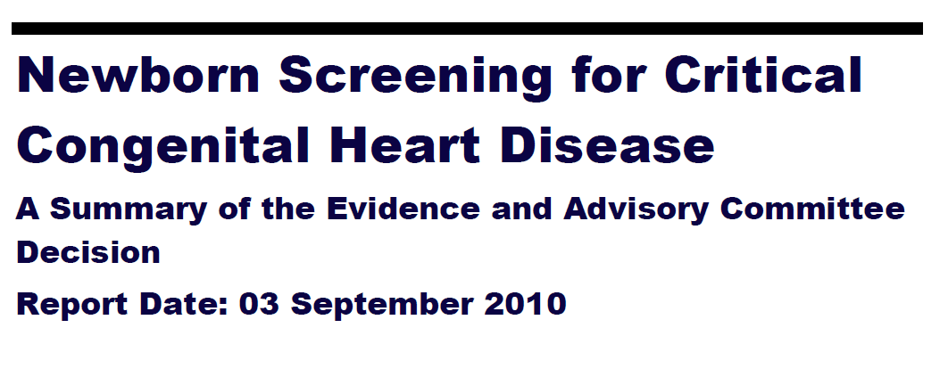
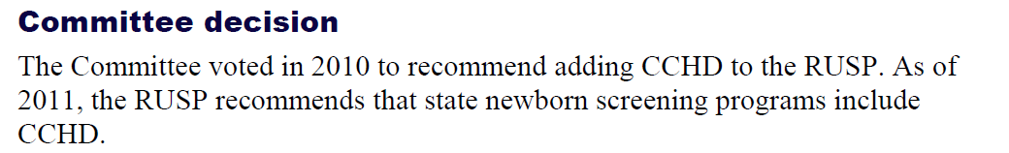
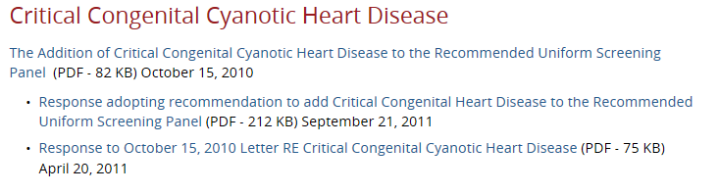
https://www.hrsa.gov/sites/default/files/hrsa/advisory-committees/heritable-disorders/rusp/previous-nominations/cchd-27-june-2018.pdf

Slide 9
CCHD Roadmap
European Science
USA Science
2009 AHA/AAP
Statement &
Granelli BMJ
338:2009
HRSA
Stakeholder
Meeting #1
SACHDNC
2010

Slide 10
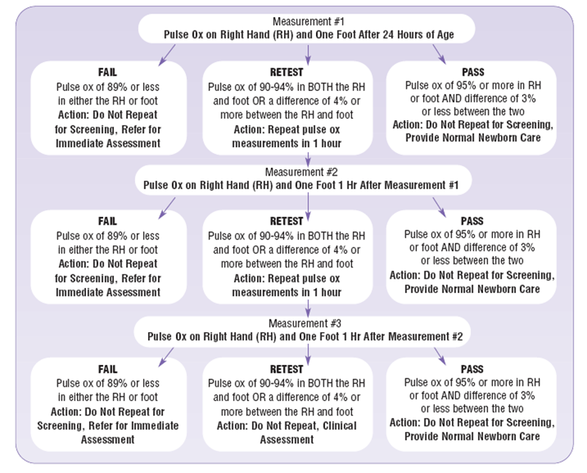

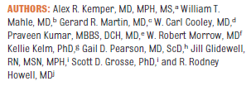
HRSA Workgroup Meeting on Screening at ACC Heart House; January, 2011

Slide 11
CCHD Roadmap
European Science
Societal
Support
USA Science
2009 AHA/AAP
Statement &
Granelli BMJ
338:2009
HRSA
Stakeholder
Meeting #1
SACHDNC
2010

Slide 12



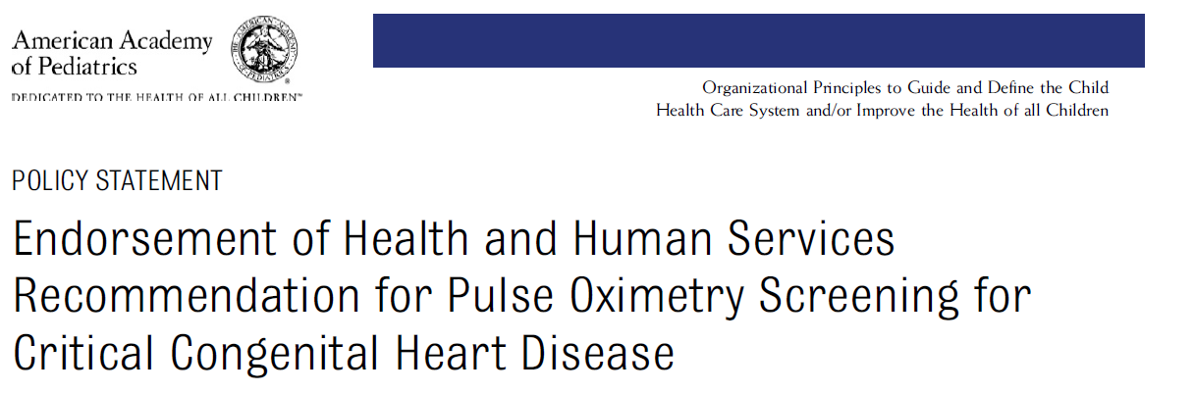

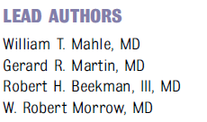

Slide 13
CCHD Roadmap
Early State Legislation
European Science
Societal
Support
USA Science
2009 AHA/AAP
Statement &
Granelli BMJ
338:2009
HRSA
Stakeholder
Meeting #1
SACHDNC
2010

Slide 14
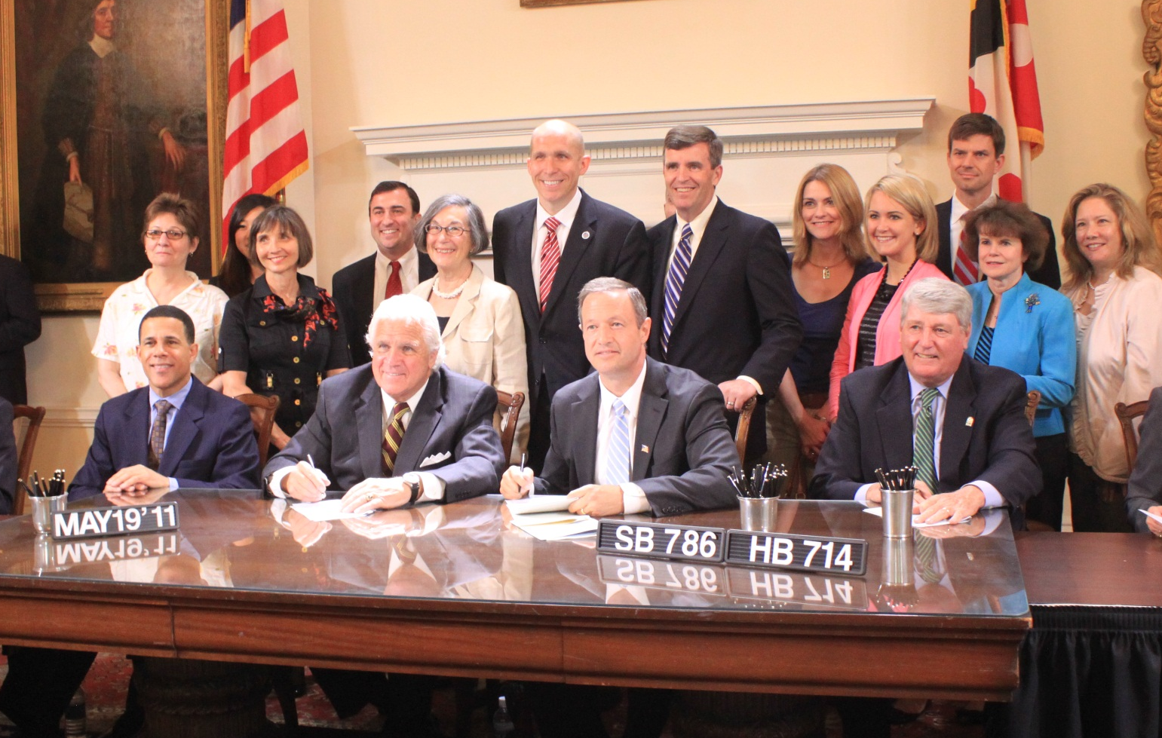
State Advocacy
Maryland Bill Signing May 19, 2011
2011: Indiana and Maryland first states to pass CCHD screening legislation. New Jersey first state to implement universal CCHD screening.
Notes:
Through guidance from the Child Health Advocacy Institute and our department of government affairs, we worked with parent advocates Olivia and Kevin Easley, Delegate Tom Hucker and Senator Karen Montgomery to introduce a bill in the state of Maryland, mandating the evaluation and creation of implementation standards for the state.
On May 19, 2011 Maryland became the first state to sign legislation related to pulse oximetry screening and we are currently working with the DOH to complete this. Later that month, the state of New Jersey signed legislation to mandate screening of all newborns- New Jersey was the first state to mandate screening.

Slide 15
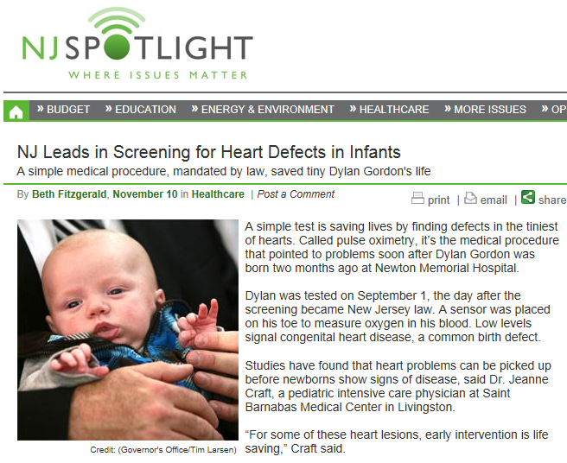

Slide 16
CCHD Roadmap
Early State Legislation
European Science
Societal
Support
HHS
Letter
USA Science
2009 AHA/AAP
Statement &
Granelli BMJ
338:2009
HRSA
Stakeholder
Meeting #1
SACHDNC
2010

Slide 17
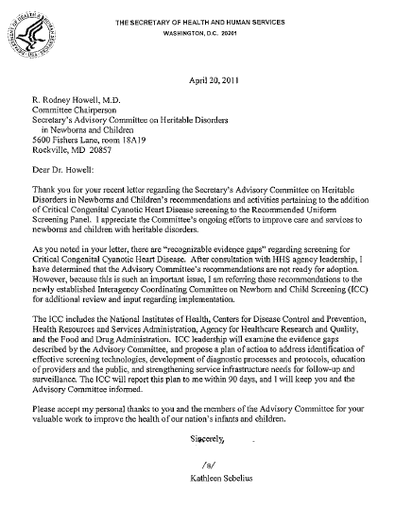
“Not ready for adoption”
“Recognizable evidence gaps”
Interagency Coordinating Committee on
Newborn and Child Screening (ICC)
(NIH,CDC,HRSA,AHRQ,FDA)

Slide 18
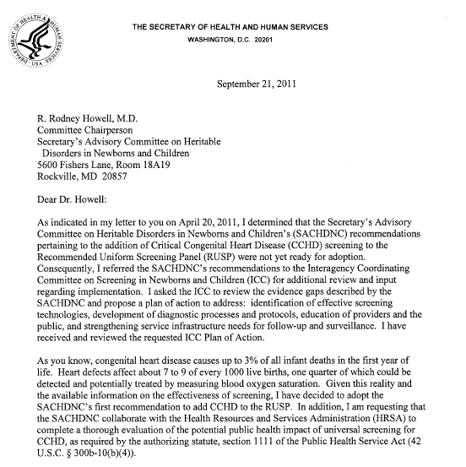
CCHD Screening final endorsement by Secretary Sebelius; September, 2011

Slide 19

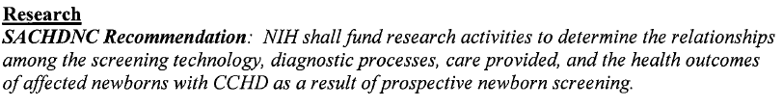

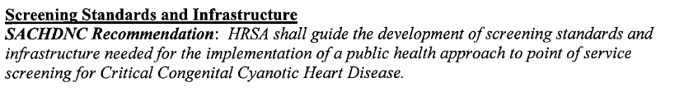
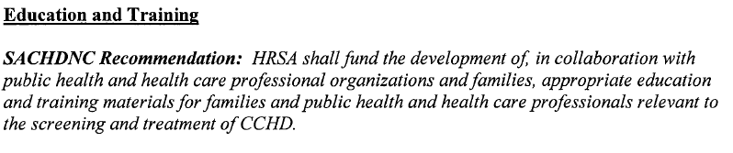
ICC Recommendations

Slide 20
CCHD Roadmap
Early State Legislation
European Science
Societal
Support
HHS
Letter
USA Science
2009 AHA/AAP
Statement &
Granelli BMJ
338:2009
Stakeholder
Meeting #2
HRSA
Stakeholder
Meeting #1
SACHDNC
2010

Slide 21
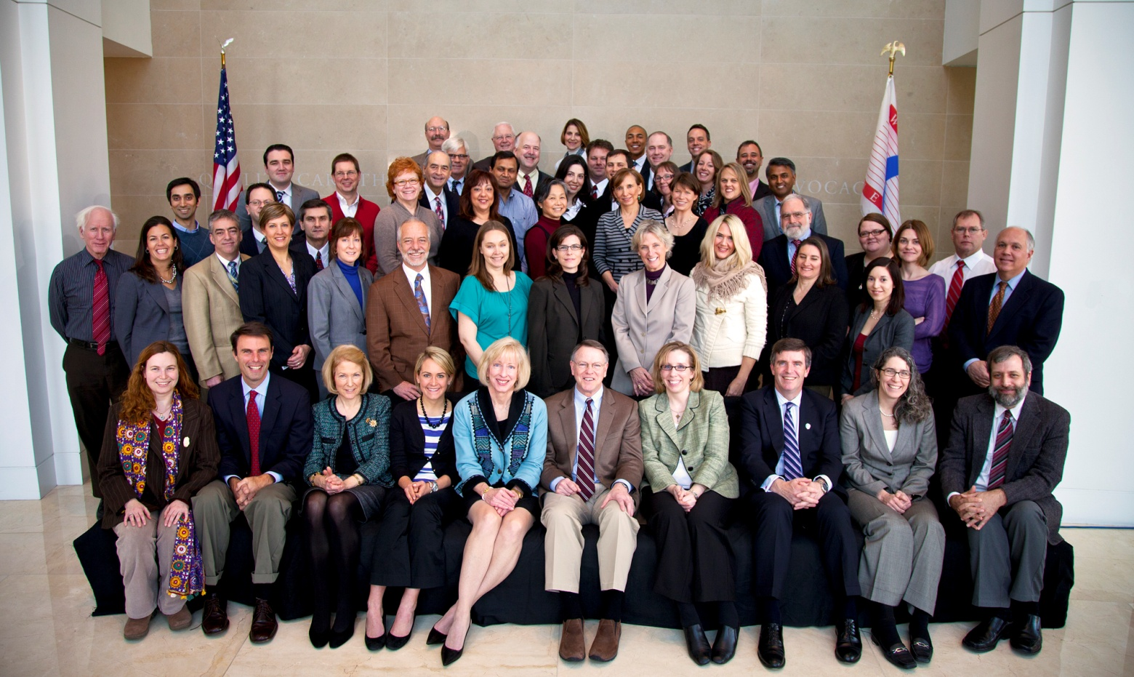
2nd Stakeholders Meeting on Screening at ACC Heart House February 10, 2012
- Industry
Government
Scientists
Cardiologists
Nursing
Associations
MCHB Programs
State DOHs
Research, Advocacy and Legislation, Equipment, Reporting, Education

Slide 22
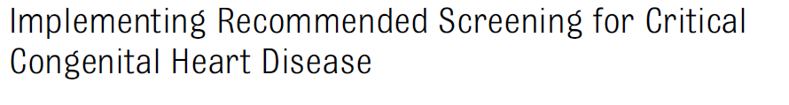
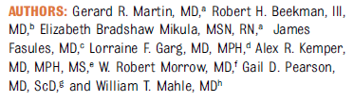
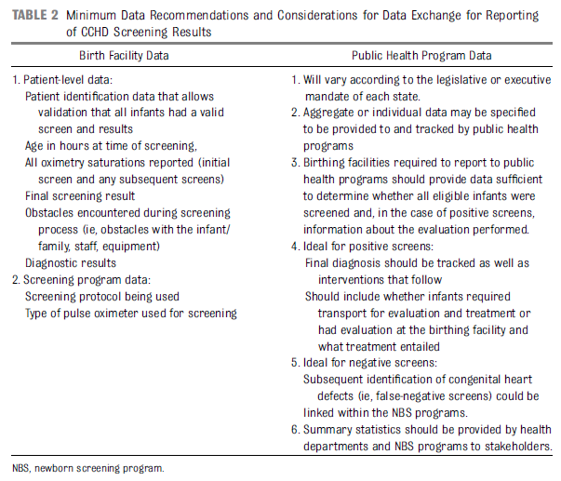
Equipment
Reporting
Training/Education
Research
Payment
Public Health Oversight
Advocacy

Slide 23
CCHD Roadmap
Early State Legislation
European Science
HRSA Grants
Societal
Support
HHS
Letter
USA Science
2009 AHA/AAP
Statement &
Granelli BMJ
338:2009
Stakeholder
Meeting #2
HRSA
Stakeholder
Meeting #1
SACHDNC
2010

Slide 24
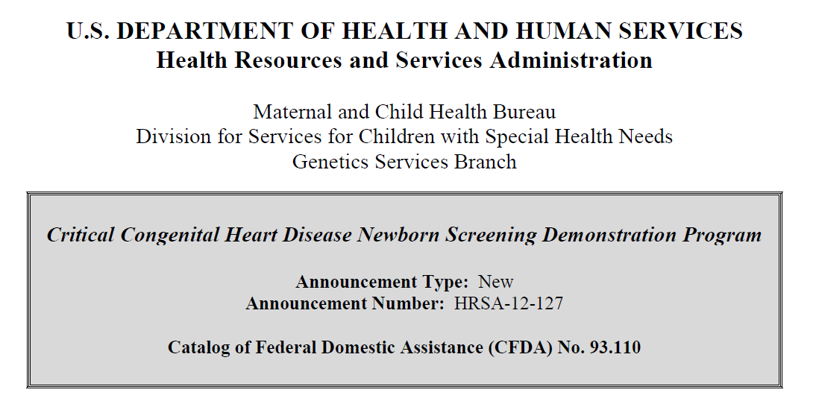
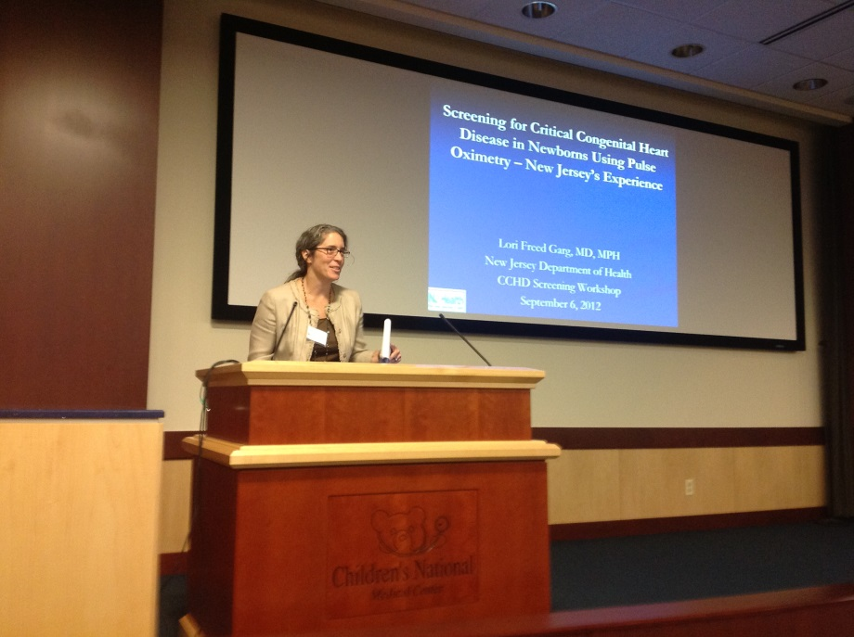
September 2012 CCHD Screening Workshop
at Children’s National in Washington, DC

Slide 25
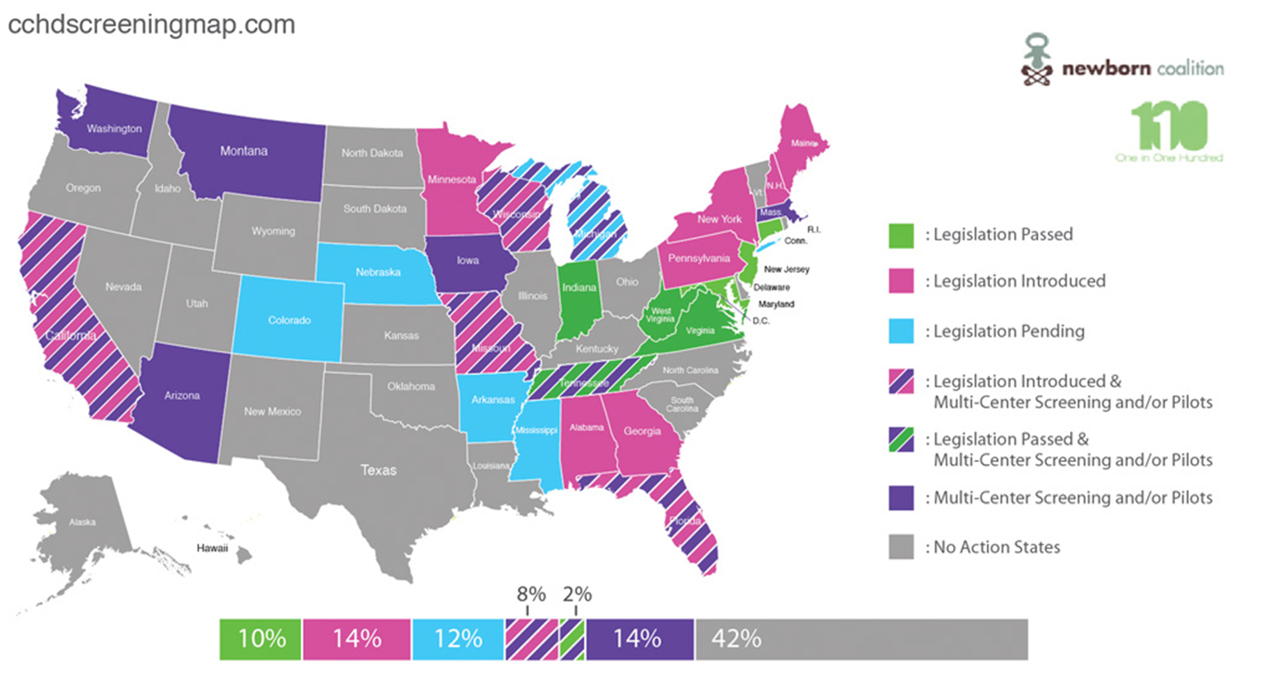
HRSA Grants
Wisconsin
Michigan
New Jersey
New Hampshire
Vermont
Rhode Island
Maine
Utah
Virginia
Develop CCHD Screening plans to implement, report, educate, train professionals
Collecting and reporting of results, document and track results of screening

Slide 26
CCHD Roadmap
NewSTEPs/APHL
Early State Legislation
European Science
HRSA Grants
Societal
Support
HHS
Letter
USA Science
2009 AHA/AAP
Statement &
Granelli BMJ
338:2009
Stakeholder
Meeting #2
HRSA
Stakeholder
Meeting #1
SACHDNC
2010

Slide 27
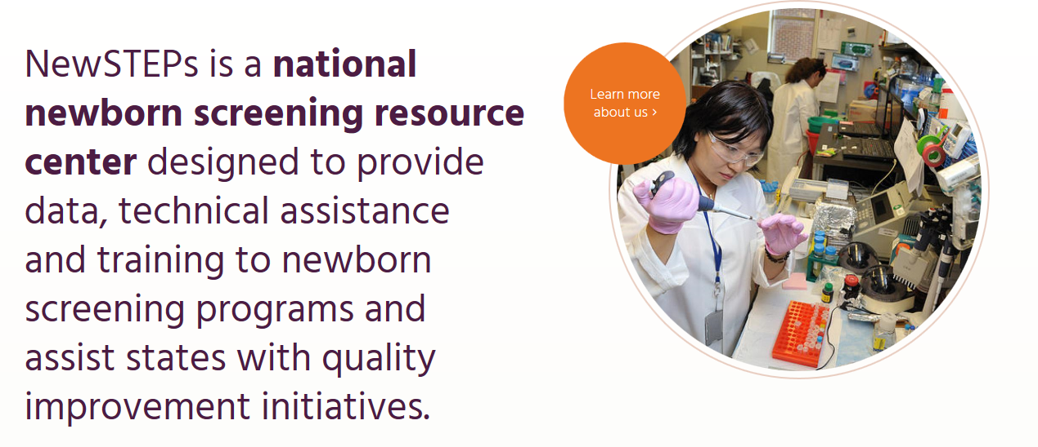
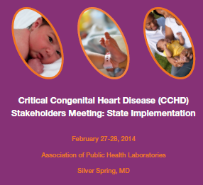

Face to Face Meeting
Regular Webinars

Slide 28
CCHD Roadmap
NewSTEPs/APHL
Early State Legislation
CDC Paper
European Science
HRSA Grants
Societal
Support
HHS
Letter
USA Science
2009 AHA/AAP
Statement &
Granelli BMJ
338:2009
Stakeholder
Meeting #2
HRSA
Stakeholder
Meeting #1
SACHDNC
2010

Slide 29
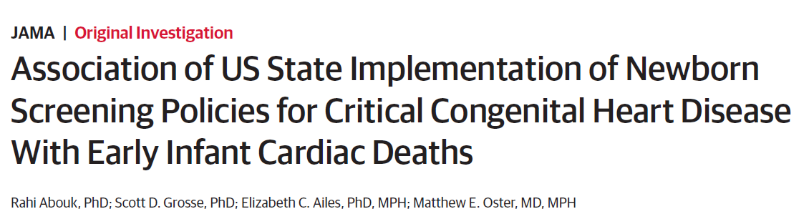
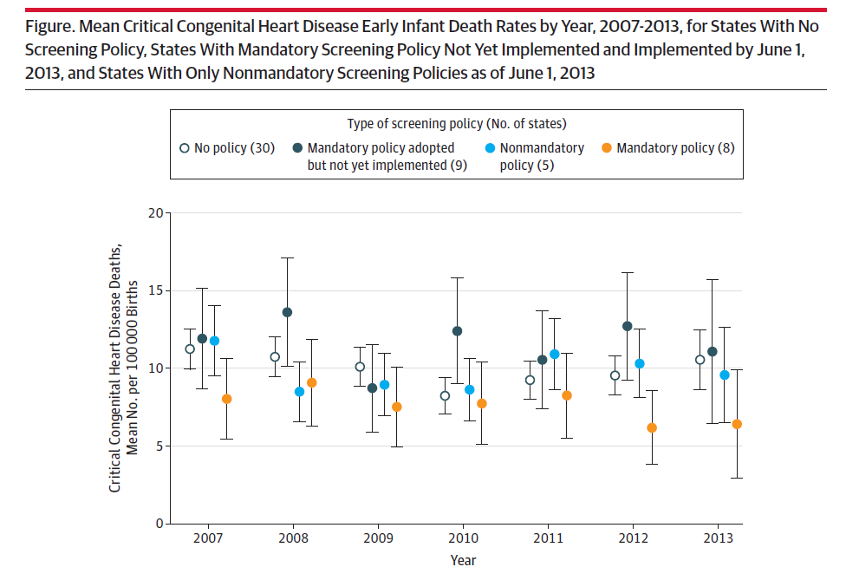


Slide 30
CCHD Roadmap
NewSTEPs/APHL
Early State Legislation
CDC Paper
European Science
HRSA Grants
Societal
Support
HHS
Letter
USA Science
All States
on Board
2009 AHA/AAP
Statement &
Granelli BMJ
338:2009
Stakeholder
Meeting #2
HRSA
Stakeholder
Meeting #1
SACHDNC
2010

Slide 31
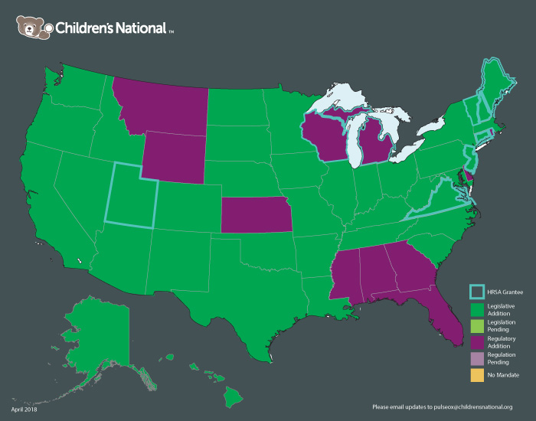
United States Efforts as of 2018
Insert here 2016 US map with VT as regulation pending and KS as fully implemented but no mandate
Approaching 98%!
Notes:
Current total is 48 states, Idaho and Kansas are screening without mandates. U.S. is now around 99% of births being screened (4 million births a year, remaining states are comparatively small…
CA makes up 12.6% of US births, NY about 6%; KS only 1 % (~40,000) and only ~6 or 7,000 births in WY and VT (0.2% for each). Idaho is 0.6% (~22,000 births/year)

Slide 32
CCHD Roadmap
NewSteps/APHL
Early State Legislation
CDC Paper
European Science
HRSA Grants
Societal
Support
HHS
Letter
USA Science
All States
on Board
Today
2009 AHA/AAP
Statement &
Granelli BMJ
338:2009
Stakeholder
Meeting #2
HRSA
Stakeholder
Meeting #1
SACHDNC
2010

