Slide 1


Slide 2
Overview of the NewSTEPs New Disorders Implementation Project
Kshea Hale, MPH
Sr. Specialist, Newborn Screening and Genetics
This work was supported by the Association of Public Health Laboratories through the Health Resources and Services Administration (HRSA) of the U.S. Department of Health and Human Services (HHS) under grant number # UG9MC30369 New Disorders Implementation Project for $4,000,000.This information or content and conclusions are those of the author and should not be construed as the official position or policy of, nor should any endorsements be inferred by HRSA, HHS or the U.S. Government.

Slide 3
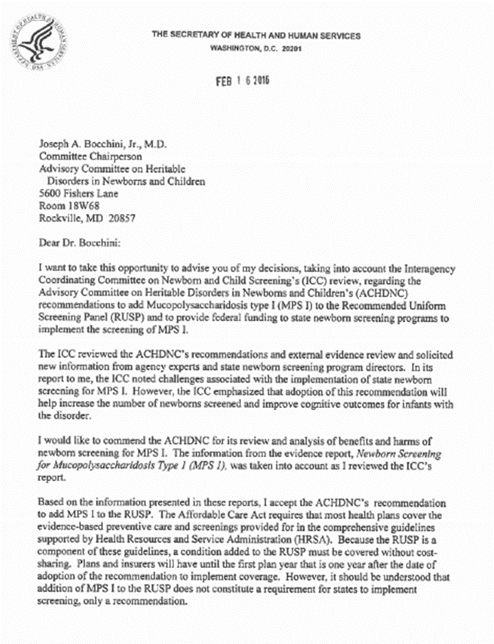
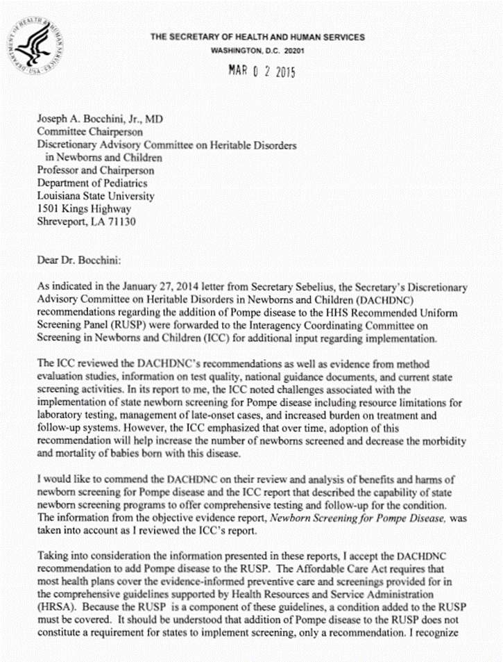

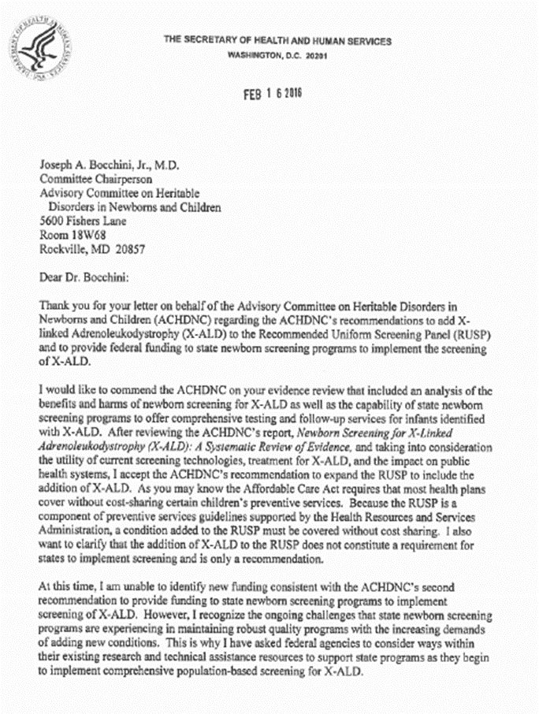
Background
“I accept the ACHDNCS’s recommendation to expand the RUSP to include the addition of
X-ALD.”
Pompe
Incidence of 1 in 40,000 births
MPS I
Incidence of 1 in 100,000 births
X-ALD
Incidence of 1 in 17,000 people worldwide
“I accept the ACHDNCS’s recommendation to add Pompe disease to the RUSP.”
“I accept the ACHDNCS’s recommendation to add MPS I to the RUSP.”

Slide 4
State Considerations for Adding a Disorder
Cost to screen
Technology
Algorithms
Fee Increases
Accepted treatment
Access to care
Clinical referral networks
Late onset versus early onset
Insurance factors
Health equity and public health service
Staffing

Slide 5
NewSTEPs New Disorders Implementation Project: Overview
Two-year cooperative agreement
Implementation of newborn screening for Pompe Disease, Mucopolysaccharidosis type I (MPS I) and X-linked Adrenoleukodystrophy (X-ALD)
Support NBS programs through technical and financial means to achieve full implementation of newborn screening for at least one of the new conditions by September 2018

Slide 6
NewSTEPs New Disorders Implementation Project: Goals
Goal 1: Assess needs and allocate resources for new disorder integration in newborn screening systems
Goal 2: Authority to implement screening
Goal 3: Implementation of laboratory and follow-up screening
Goal 4: Community, parent, and provider education

Slide 7
NewSTEPs New Disorders Implementation Project: Key Objectives and Activities
Funding mechanism
Formal application
New Disorders Readiness Tool
Peer Network Resource Centers (PNRCs)
Annual Meetings
National Webinars

Slide 8
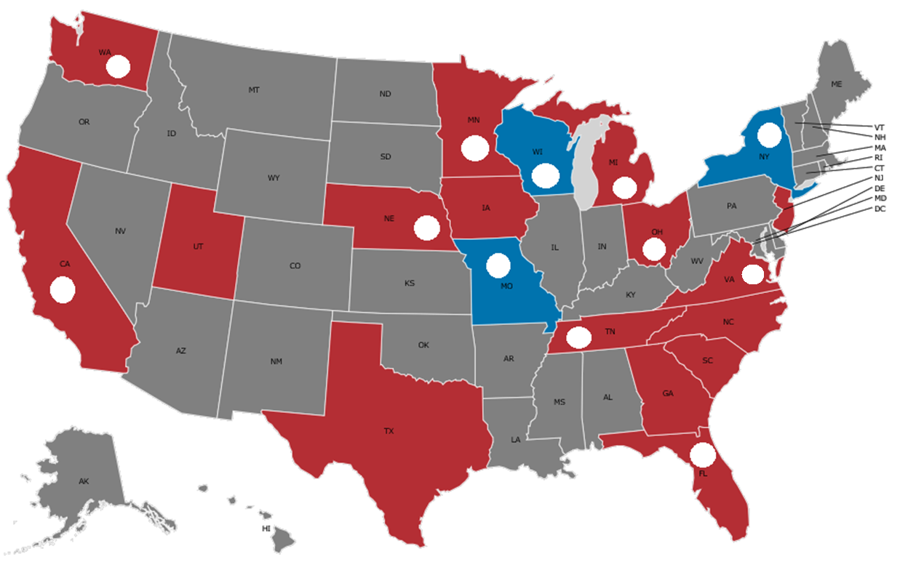


NewSTEPs New Disorders Implementation Project Subawardees

Slide 9
New Disorders NBS Readiness Phases
Phase 1- Approval/Authority to Screen and Approval of Funding
Phase 2- Lab, Follow-Up, and Information Technology Logistics
Phase 3- Education
Phase 4- Full Implementation

Slide 10
New Disorders NBS Readiness Phases
Phase 1- Approval/Authority to Screen and Approval of Funding
Milestones:
Obtain approval from NBS Advisory Committee
Obtain approval by the Board of Health/Commissioner
Obtain IRB approval for pilot testing
Obtain approval by NBS Advisory Committee for increase in funding
Obtain approval by the State Budget Authority

Slide 11
New Disorders NBS Readiness Phases
Phase 2- Lab, Follow-Up, and Information Technology Logistics
Milestones:
Ensure facility/infrastructure readiness
Acquire equipment and determine screening assay
Determine cut-offs
Establish Follow-up protocols
Integrate disorder into LIMS
Integrate disorder into electronic order

Slide 12
New Disorders NBS Readiness Phases
Phase 3- Education
Milestones:
Education for families
Education for providers
Education for general public

Slide 13
New Disorders NBS Readiness Phases
Phase 4- Full Implementation
Milestones:
Pilot population testing
Implement statewide screening for all newborns

Slide 15
Utilization of Funding

Slide 16
Key Milestones Achieved/Successes
Implemented statewide universal screening for all three conditions
Implemented 2nd tier testing for Pompe and MPS I
Created and deployed an online education module
Validated pipeline with CFTR data
Completed building retrofit
Optimization of first tier testing
Screened approximately 51,404 newborns for X-ALD
Educated 500 health care professionals across the state
Completed validation for 2nd tier molecular full gene sequencing
Hosted a successful DCE event
Developed a novel FIA-MS/MS methodology to improve turnaround time
Held annual X-ALD Stakeholder Meetings
Generated results for over 25,800 specimens for PE LSD kit FDA data review
Secured fee increase for NBS program
Completed in-depth qualitative interviews with 24 families

Slide 17
Challenges
Staffing
Hiring process
Lack of NBS disorder specific public data for pipeline validation
Higher than expected false positive rates and referrals
Delays in construction of new laboratory space
Delay in FDA approval of Neobase2 kit
No shared genomic variant database specific to NBS disorders
Statewide delay by LIMS vendor to complete upgrade
Delays in processing regulations due to moratorium
Complicated and delayed state procurement process
Difficulty recruiting underrepresented populations
Discontinuation of columns that were recommended for use in the LC/MS/MS method for ALD
Scheduling meetings with external stakeholders to develop LTFU program
New MS/MS instruments did not perform as expected
Funding was not approved during legislative session

Slide 18
Laboratory Information Management Systems (LIMS)
Time
Delays
Second- tier
Staffing
Relationships
Special baby populations
Key Lessons Learned

Slide 19
Feedback and Recommendations
Collaboration
Uniformity
Unity

Slide 20
Next Steps for Subawardees
Establish exome sequencing lab protocols
Move forward with testing using Q-sites
Train staff on methodology
Complete sequencing assay validation
Integrate disorder in LIMS
Complete pilot study
Implement screening for all 3 conditions
Monitor screening outcomes
Optimize clinical laboratory process
Refine cut-offs and reporting algorithms
Add second-tier testing
Continue to develop a LTFU program

Slide 21
Peer Network Resource Centers: New York, Missouri, and Wisconsin
Examples:
Provided sample panels for validation and tested samples for comparison analysis
Provided educational resources
Held an annual Tandem Mass Spectrometry, DNA Sequencing and Follow-Up Hands-on workshop
135 activities of support
Provided direct assistance to 24 state NBS programs
Facilitated technical assistance via webinars, on-site visits, in-person meetings, hands-on workshops, and phone calls

Slide 22
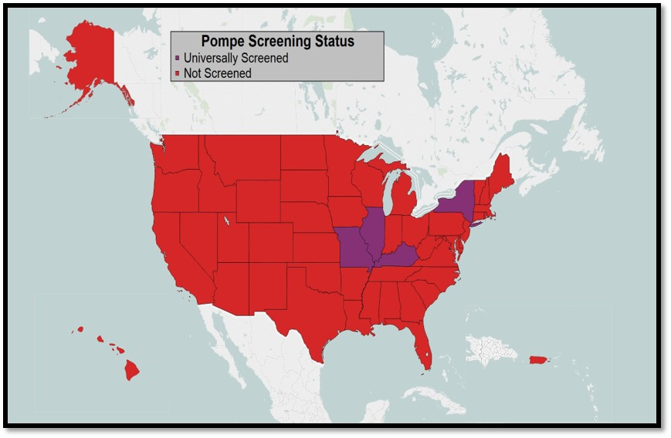
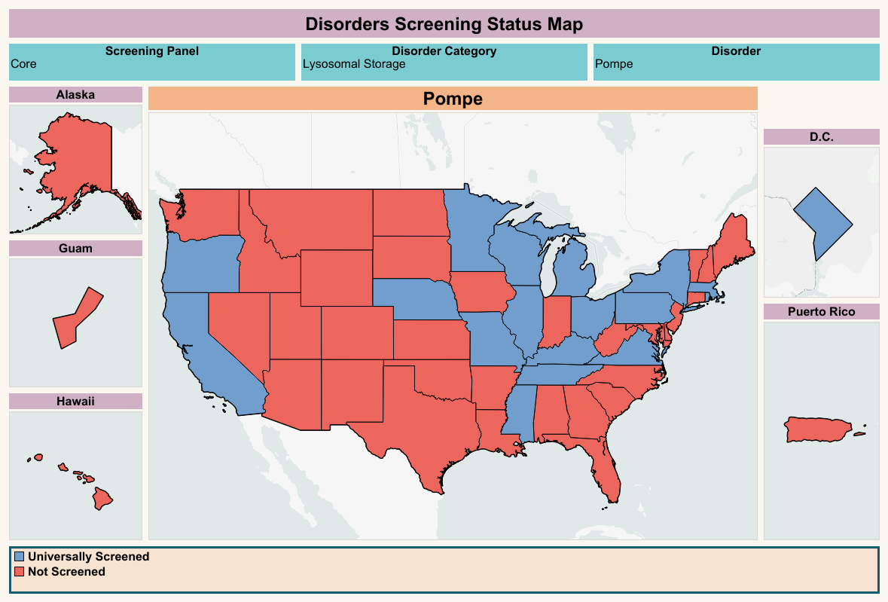
Progress in New Disorders NBS Implementation: Pompe
2016
2019

Slide 23
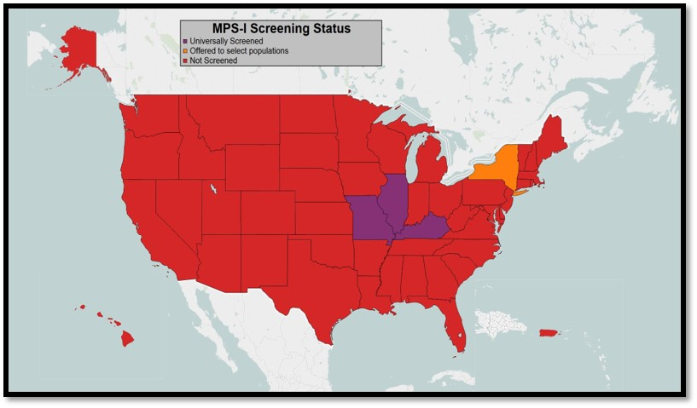
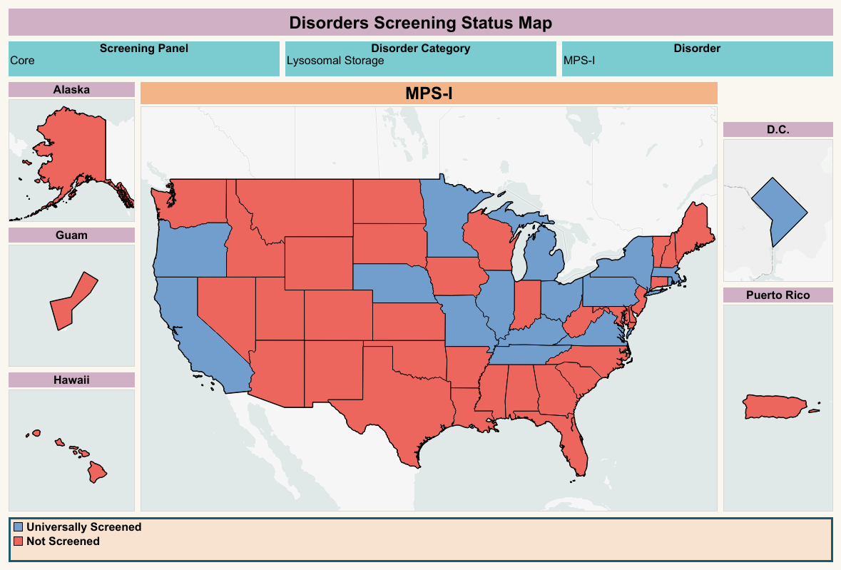
Progress in New Disorders NBS Implementation: MPS I
2016
2019

Slide 24
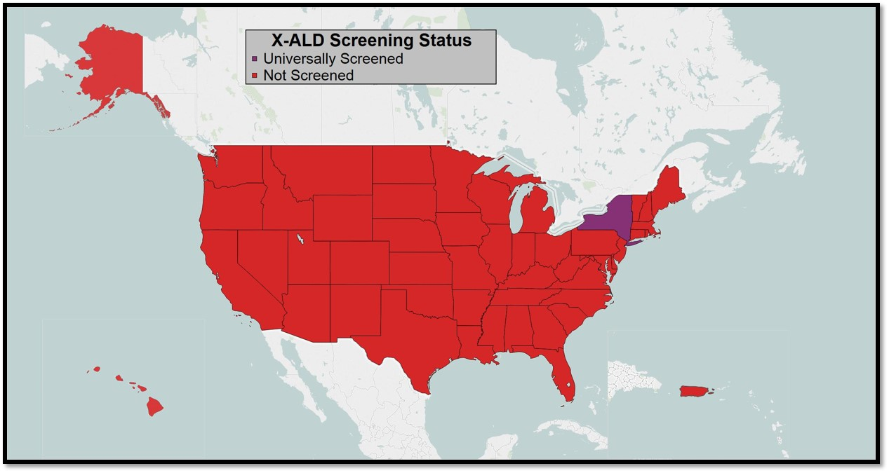
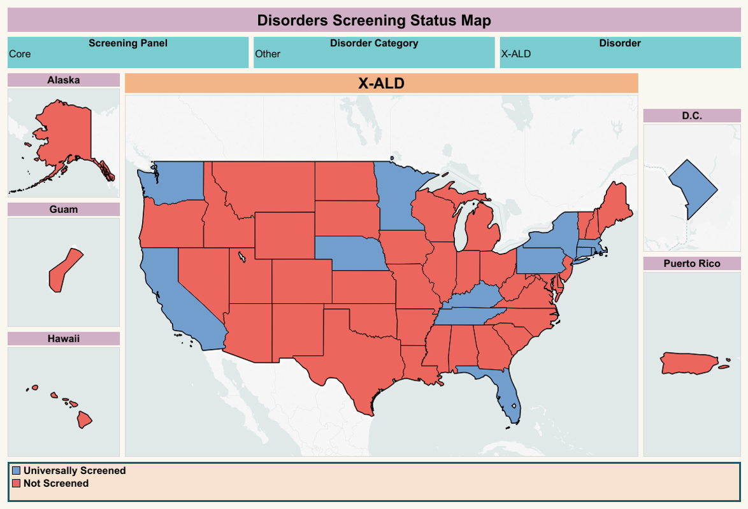
Progress in New Disorders NBS Implementation: X-ALD
2016
2019

Slide 25
APHL NewSTEPs: Current and Future New Disorders Activities
New Disorders Implementation Project currently in a no-cost extension through August 2019
Fund Onsite TA to Missouri, New York, and Wisconsin NBS programs
New Disorders activities will continue (beyond MPS I, Pompe, x-ALD)
Provide support for SMA
Convene a New Disorders Workgroup

Slide 26

Special Thanks!!!
Mei Baker
Natasha Bonhomme
Michele Caggana
Patrick Hopkins
Yvonne Kellar-Guenther
Sikha Singh

Slide 27

Kshea Hale
Kshea.Hale@aphl.org
240.485.3842

